Slide 1


Center for International Mediators and Arbitrators
England & Wales
The Law of Obligations
MODULE 2
Dr Osei Bonsu Dickson Esq., FCIMArb

Slide 2
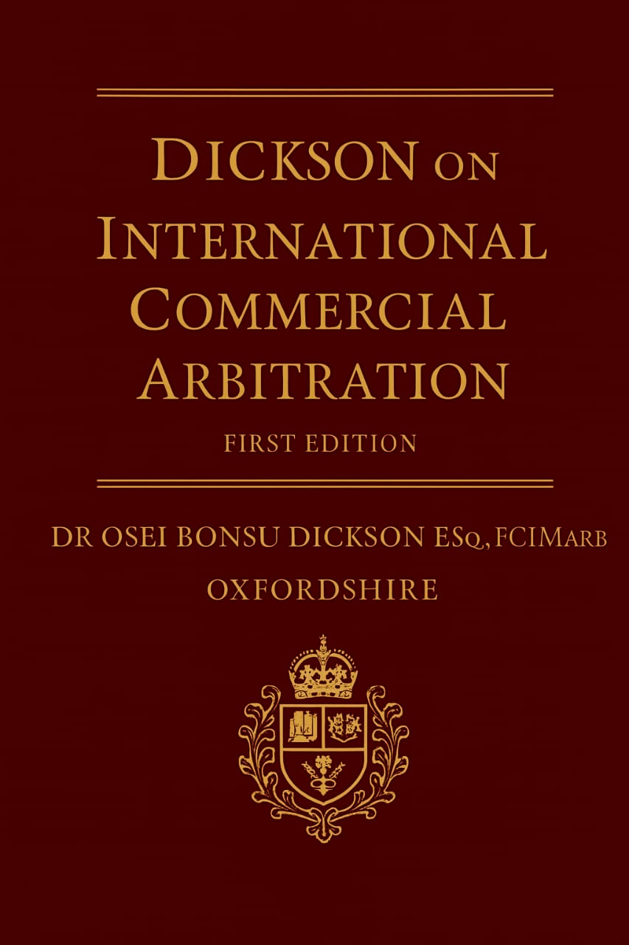
Center for International Mediators and Arbitrators
England & Wales
Center for International
Mediators and Arbitrators
England & Wales
OXFORDSHIRE
T: +23353 673 5535

Slide 3



Introduction
Law of Obligations
Central to Arbitration
Rules governing legally enforceable duties between parties
Defines rights, breaches, remedies, and enforceability
Cross-Border Enforcement
Arbitration enforces obligations across borders where parties choose neutrality
The law of obligations forms the foundation upon which international arbitration operates, providing the legal framework that enables parties to resolve disputes efficiently across different jurisdictions.

Slide 4

Relevance
International arbitration is anchored in agreements—arbitration clauses, submission agreements, and the underlying commercial contracts. The law of obligations determines how such contracts are formed, interpreted, enforced, and breached,
When disputes arise, arbitral tribunals must evaluate fault, causation, breach, damages, and restitution. These are quintessential features of the law of obligations. Without it, tribunals would lack principled bases for awarding compensation, specific performance, or other remedies.
Conflict-of-Laws and Governing Law Analysis:
International arbitration routinely involves parties from different jurisdictions. The law of obligations guides the selection and application of the governing law

Slide 5

What Are Legal Obligations?
A legal obligation is a duty recognised and enforceable by law. It arises when one party is bound to act (or refrain from acting) for another's benefit.
Obligations underpin every arbitration claim—there is no dispute without a duty breached.
Understanding the nature and scope of legal obligations is essential for both practitioners and parties engaged in international arbitration proceedings.

Slide 6



Three Pillars of the Law of Obligations
1
Contractual
2
Non-Contractual
3
Restitutionary
Contractual Obligations
Non-Contractual Obligations
Restitutionary Obligations
Arise from agreements voluntarily entered into. Parties determine their rights, responsibilities, and dispute mechanism.
Imposed by law, not by agreement—e.g., negligence, fraud, unjust enrichment.
Prevent one party from retaining an unfair benefit.
These pillars determine the tribunal's mandate, applicable remedies, and legal reasoning in
international arbitration proceedings.

Slide 7

Obligations in International Arbitration
01
02
What was promised?
Was it breached?
Tribunals examine the nature and scope of obligations undertaken by parties
Assessment of whether parties fulfilled their duties or failed to perform
03
What remedy applies?
Determination of appropriate relief based on the breach and applicable law
Arbitration enforces obligations across different legal systems. These obligations guide both procedural and substantive decisions throughout the arbitral process.

Slide 8
The Arbitration Agreement
1
2
3
Binding Obligation
Key Elements
Party Autonomy
A commitment to resolve disputes privately through arbitration
Seat, rules, governing law, arbitrator selection
Upholds party choice and removes court jurisdiction
The arbitration agreement itself is a fundamental obligation that forms the jurisdictional basis for the tribunal's authority to hear and determine disputes.

Slide 9

Performance & Breach
Performance
Fulfilling agreed obligations according to
contract terms
Breach
Failure to perform a duty as required
Arbitration
Breach triggers proceedings and informs
damages/sanctions

Slide 10




Contractual Interpretation
Tribunals interpret unclear clauses using established principles to determine
the parties' true intentions and obligations.
Natural Meaning
Commercial Purpose
Words given their ordinary and natural
meaning in context
Interpretation aligned with business
objectives and intent
Trade Usage
Good Faith
Industry customs and practices inform
Interpretation
Parties expected to act honestly and
reasonably
These principles are harmonised by CISG,
UNIDROIT Principles, and common international practice.

Slide 11

Good Faith & Reasonableness
Civil Law Tradition
Foundational duty in all contracts, deeply embedded in legal systems
Common Law Approach
Emerging doctrine with case-specific application
International Arbitration
Increasingly used to evaluate party conduct and contractual performance

Slide 12

Non-Contractual Obligations
Tort/Delict
Professional Responsibilities
Negligence
Economic loss
Engineers
Misrepresentation
Architects
Financial experts
Tribunal Jurisdiction
If arising "out of or in connection with" the contract, tribunals may assume jurisdiction
Non-contractual obligations imposed by law can fall within the scope of arbitration agreements when sufficiently connected to the underlying contractual relationship.

Slide 13

Restitution & Unjust Enrichment
Preventing Unjust Gain
Restitution prevents unjust gain at another's expense. It arises where a benefit is received that lacks legal justification.
Investment Disputes
Construction Claims
Recovery of funds improperly retained
Payment for work performed without valid contract
Services Disputes
Compensation for benefits conferred

Slide 14

Remedies Available in
Arbitration
Monetary Damages
1
Expectation damages
Reliance damages
Restitution damages
Financial Adjustments
2
Interest calculations
Exchange rate adjustments
Specific Performance
3
Ordered where permitted by applicable law
Liquidated Damages
4
Enforced unless deemed penal in nature

Slide 15

Evidence & Burden of Proof
1
Claimant's Burden
Must prove breach and resulting loss
2
Expert Testimony
Vital in technical and complex disputes
3
Disclosure Requirements
Guided by ICC, LCIA, SIAC, UNCITRAL rules
The evidentiary framework in international arbitration balances efficiency with fairness, ensuring parties can present their case while maintaining procedural economy.

Slide 16




Key Takeaways & Discussion
Legal Backbone
Clear Duties
Obligations form the legal backbone of arbitration
Clear duties reduce disputes and enhance enforceability
Better Outcomes
Leading Forum
Understanding obligations improves advocacy and arbitral outcomes
Arbitration remains the leading forum for resolving
cross-border obligations

Slide 17
Discussion Points
Should tribunals impose a universal duty of good faith?
Are liquidated damages clauses always enforceable?
Can non-contractual obligations fall under arbitration clauses?
When should specific performance be preferred over damages?
Thank you for your attention.

Slide 18
Center for International Mediators and Arbitrators
England & Wales
Recommended Reading List
Foundational Texts
Osei Bonsu Dickson, International Commercial Arbitration (1st Edition, 2025)
Gary Born, International Commercial Arbitration (3rd Edition, 2021)
Emmanuel Gaillard & John Savage, Fouchard, Gaillard, Goldman on International Commercial Arbitration (1999)
Julian D.M. Lew, Comparative International Commercial Arbitration (2003)
Primary Sources & Current Research
UNCITRAL Arbitration Rules and Model Law texts (official website)
International Council for Commercial Arbitration (ICCA) publications
Recent articles: Charles Russell Speechlys, Skadden, WilmerHale insights on 2025 arbitration trends

Slide 19
Center for International Mediators and Arbitrators
England & Wales
Q & A

