Slide 1

Diversity, Inclusion & the Future of Dispute Resolution
CIMA Global Webinar Series — 29 August 2025
Dr Misha Kumar, FCIArb
Notes:
20:50–20:54 — Opening
Good evening from New Delhi. Warm greetings to friends joining from Ghana, South Africa, Hong Kong, England and Wales—and of course to our host, the Center for International Mediators and Arbitrators. Thank you, Dr. Osei, for this generous invitation.
Welcome everyone. Thank you, Dr Osei, and CIMA. This session is practical and non-technical: we’ll connect why tribunal composition matters to real appointment decisions and concrete actions you can take on Monday. I’ll reference institutional rules and soft-law only at a high level, and keep reiterating an important boundary: party autonomy governs—no statute or case forces private parties to pick “diverse arbitrators.”
My thesis tonight is simple: diversity isn’t optics—it’s performance. Who sits on a tribunal shapes how facts are understood, how law is reasoned, and how awards travel across borders. I’ll move from doctrine to data to do-ables, with a practical playbook for counsel, institutions, arbitrators, and clients.” If rushed (15s): “Diversity is a performance variable. Tonight: doctrine → data → do-ables.”
Our aim is to show how quality and legitimacy improve when we widen who gets considered, and how pledges translate into routine practice.
Transition: “Here’s our road map.”

Slide 2






Agenda
Foundations: Why Diversity Belongs at the Core
The legal architecture and doctrinal foundations that place diversity at the heart of arbitral legitimacy.
Evidence, Law-Finding & Award Acceptability
How diverse tribunals enhance quality of decision-making and award enforcement.
Appointments, Disclosure & Challenge
Critical junctures where diversity is won or lost in arbitral practice.
Comparative Systems & Public Law Analogies
Lessons from jurisdictional approaches and judicial diversity initiatives.
Data & User Perspectives
What empirical evidence tells us about diversity in international arbitration.
Operational Playbooks
Practical strategies for counsel, institutions, and arbitrators to enhance inclusion.
Notes:
Our theme tonight is “Diversity, Inclusion and the Future of Dispute Resolution.” I speak as an arbitrator, counsel, and teacher—and as a woman who has spent much of her career persuading rooms to widen the circle of trust. My simple proposition is this: diversity is not optics; it is performance. It improves deliberation quality, strengthens legitimacy, and future-proofs international arbitration as a truly global service.
“We’ll cover: (1) what diversity means in arbitration, (2) how it affects evidence and law-finding, (3) the legal architecture—Model Law & NYC, (4) where appointments get stuck, (5) comparative perspectives, and (6) a Monday-morning playbook.” If rushed: “Foundations, effects, law, choke-points, comparisons, playbook.” Transition: “First, align on the core concept.”

Slide 3
Our Central Thesis
Diversity is not optics—it is performance.
Arbitration began as a private, contractual process, yet today it stands on a public-facing scaffold of legislation, conventions, and institutional rules. In such a system, who sits is a legal and legitimacy variable, not decoration.
The future of dispute resolution will be decided by whether our tribunals can see what our parties see—across cultures, languages, industries, and legal traditions.
"If everyone is thinking alike, then no one is thinking."
Notes:
20:54–21:02 — What arbitration is (and why diversity belongs at its core)
Arbitration is often described as private and consensual. Parties contract out of court and into a tribunal; party autonomy is foundational. Yet modern international arbitration is no longer a purely private creature—it rests on an edifice of national statutes, conventions, and institutional rules; it is a public-facing system with global impact. That is precisely why who sits in judgment matters. If our users are global but our tribunals are narrow, the system under-delivers on its promise
Diversity, in this context, is not limited to gender. It includes age, geography, language, legal culture, professional background, and lived experience. Teams that are heterogeneous see more: more risk, more nuance, more practical solutions. Empirically and experientially, diverse groups outperform in decision-making; the same is true of tribunals—cohesion improves, blind spots shrink, and the quality and acceptability of awards rises.
“Arbitration is contractual, but it lives in a public law ecosystem—statutes, conventions, seat law. In that system, tribunal composition is a legal variable. It influences fairness perceptions, procedural choices, and enforceability risk.” If rushed: “Composition is not cosmetic; it’s legally consequential.” Transition: “Let’s see how it changes fact-finding.”
“If everyone is thinking alike, then no one is thinking.” That aphorism is not a slogan; it is a design rule for how we constitute tribunals.
Micro-prompt (30s): Ask participants to think of one case where a cultural or sectoral perspective changed how evidence was understood. Invite two quick shares.

Slide 4

Evidence & Fact-Finding Enhancement
How Diverse Tribunals Improve Fact-Finding
Cultural and sectoral lenses shape how tribunals weigh testimony, industry usages, and interpret silence in records
Mixed panels interrogate assumptions from multiple directions, reducing blind spots
Heterogeneous knowledge backgrounds lead to more robust findings of fact
Different life experiences enable scrutiny of implicit biases in witness credibility assessment
Tribunals composed of members with varied backgrounds are better equipped to understand nuanced cultural contexts and industry-specific practices that may be critical to resolving disputes.
The causality between diverse backgrounds and quality of reasoning elevates the justification quality and ultimately enhances award acceptability across different legal cultures and traditions.
Notes:
21:02–21:12 — Why diversity changes outcomes (fact-finding, law-finding, legitimacy)
First, fact-finding. Cultural background shapes how fact-finders hear witnesses, infer usage, or weigh documentary gaps. Mixed panels tend to interrogate assumptions from multiple angles, producing better grounded findings of fact.
Script: “Mixed panels interrogate assumptions from different angles. Cultural/sector lenses help interpret silence in records and demeanor in testimony. Net effect: fewer blind spots, better credibility assessments, more robust facts.” If rushed: “Mixed panels reduce blind spots and improve credibility findings.”
Decision quality and acceptability. Heterogeneous panels interrogate assumptions from multiple legal cultures and industries, improving fact-finding and the acceptability of awards across borders.

Slide 5








Law-Finding & Transnational Norms
Cross-Tradition Interpretation
Disciplined Discretion
Tribunals composed across legal traditions are likelier to select and test sources with sensitivity to party expectations grounded in different legal cultures
Diverse tribunals exercise discretion within legal frameworks with greater awareness of varying approaches to legal interpretation
Legitimacy Enhancement
Transnational Principles
Parties accept adverse outcomes more readily when the process is representative and reasons speak in a vocabulary legible across borders
International cases often turn on transnational norms or soft-law instruments when contracts are silent or clash
Diverse tribunals bridge legal traditions and enhance the legitimacy of awards by ensuring that legal reasoning resonates across jurisdictional boundaries—crucial for both enforcement and voluntary compliance.
Notes:
“Cross-tradition tribunals select and test sources with sensitivity to party expectations. Discretion is exercised comparatively; reasons are written in a vocabulary legible across systems—vital for acceptability and enforcement.” If rushed: “Diverse tribunals write reasons that travel.” Transition: “Where does the law embed this?”
Second, law-finding. International arbitration draws on transnational norms and soft law where party choices are silent. A plural tribunal is more likely to select, test, and apply those sources with sensitivity to parties’ reasonable expectations across legal cultures.
Third, legitimacy. Parties accept adverse outcomes more readily where the process feels representative. As Paula Hodges QC has observed, diversity brings richer results—and in our field, that translates directly into award legitimacy.
Transition note: Emphasize that pluralism is not licence. Diversity does not confer “unfettered powers”; it disciplines discretion. Tribunals must still reason within the law and record.

Slide 6
The Legal Architecture
1
2
UNCITRAL Model Law
New York Convention
Articles 11-12 (appointment and challenge) operationalise neutrality
Article V(1)(d) expressly ties enforceability to tribunal composition being in accord with party agreement or the law of the seat
Article 18 insists on equal treatment and full opportunity to present the case
This is the doctrinal doorway through which composition—and thus diversity—enters enforceability analysis
Article 19 protects procedural autonomy
These foundational instruments create a legal framework where tribunal composition directly impacts the validity and enforceability of arbitral awards—establishing diversity as a substantive rather than merely symbolic concern.
Notes:
Legal architecture.
Slide 6 — Model Law: Appointments (Arts. 11–12)
UNCITRAL Model Law Articles 11–12 (appointment; challenge for justifiable doubts), 18 (equal treatment), and 19 (party autonomy in procedure) frame neutrality and process fairness.
Script: “Model Law Articles 11–12 operationalise neutrality and challenge. When you propose a diverse slate under these articles, you’re not doing charity; you’re fulfilling the statute’s neutrality design with a wider, qualified pool.” If rushed: “Articles 11–12 make slate quality and breadth a legal matter.” Transition: “Equal treatment drives procedure.”
Script: “Article 18 hard-wires equal treatment and full opportunity to present the case. Language access, hearing format, and scheduling sensitivity are equality decisions—not logistics. Diverse panels tend to spot these earlier.” If rushed: “Equality choices are procedural, not cosmetic.” Transition: “Procedural autonomy next.”
“Article 19 allows parties to shape procedure. Use that autonomy to agree on slate principles, hybrid hearings, and language arrangements that reduce inequality of arms.” If rushed: “Draft procedure that levels the field.” Transition: “From seat law to the Convention.”
The New York Convention Article V(1)(d) makes award enforcement contingent on tribunal composition being in accordance with the parties’ agreement or the law of the seat—reminding us that composition is a legal, not cosmetic, question.

Slide 7

Legitimacy & Enforcement
The Enforcement Connection
The New York Convention Article V(1)(d) establishes that awards may be refused recognition if:
"The composition of the arbitral authority or the arbitral procedure was not in accordance with the agreement of the parties, or, failing such agreement, was not in accordance with the law of the country where the arbitration took place."
This establishes tribunal composition as a legal risk to enforcement, not merely an issue of optics or representation.
Homogeneous tribunals may inadvertently heighten enforcement risks if they fail to understand the legal and cultural contexts relevant to the dispute.
Parties more readily accept adverse outcomes when they perceive the tribunal as representative and capable of understanding their position within their cultural and legal framework—directly impacting voluntary compliance and enforcement prospects.
Notes:
“Perceived fairness drives compliance. When parties recognise themselves in the tribunal—by sector, language, region—they’re likelier to accept adverse outcomes without guerrilla tactics.” If rushed: “Representation boosts acceptance.” Transition: “Institutions set the lanes.”
“NYC Article V(1)(d) permits refusal if composition wasn’t per agreement or seat law. Composition thus touches enforcement risk. Robust, transparent nomination improves enforceability confidence.” If rushed: “Poor composition = enforcement risk.” Transition: “Legitimacy follows.”
Why diversity improves outcomes (4–5 minutes)
First, decision quality. Diverse tribunals are better at spotting blind spots—on industry practices, contract usages, local regulatory context, or linguistic nuance. That reduces error and improves the reasoning parties must ultimately live with.
Second, legitimacy. Cross-border users are more likely to trust a process when they can see themselves in it. Legitimacy is not only about enforcing an award under the New York Convention; it is also about persuading both sides that justice has been done.
Third, innovation. Diversity of professional backgrounds—engineering, finance, public procurement, technology—enriches tribunal management, case scheduling, and the adoption of tools like remote hearings or AI-assisted document triage. New ideas arrive with new people.

Slide 8
Institutional Rules Reinforcing Diversity
ICC Rules (2021)
LCIA Rules (2020)
Articles 12-13 govern constitution of the tribunal and Court appointments
Articles 5-7 & 10 address appointments, multi-party scenarios, and replacement
The ICC Court considers nationality, residence, and other relationships in appointments
The LCIA Court shall have regard to candidates' "qualifications, expertise, and ability"
SIAC Rules (2016)
HKIAC Admin Rules (2018)
Rules 8-10 provide appointment mechanisms and challenge procedures
Articles 9-11 establish appointment criteria and processes
HKIAC shall consider "the candidates' availability, qualifications and ability to conduct the arbitration"
The President considers "any circumstances that secure the appointment of an independent and impartial arbitrator"
These rules, read together with the IBA Guidelines on Conflicts of Interest (2014, as updated), provide counsel principled levers to widen candidate slates while maintaining independence and impartiality.
Notes:
ICC Rules 2021, Articles 12–13 (constitution of the tribunal) and the Court’s appointment practice focus on independence, impartiality, availability, and suitability for the case;
LCIA Rules 2020 Articles 5–7, 10 do the same;
SIAC Rules 2016 Rules 8–10 likewise.
Properly used, these gateways enable broader, better-matched panels.
“Rules require independence, availability, and suitability. Use those criteria to widen slates: sector fit, language, regional experience, time-zone practicality—without compromising independence.” If rushed: “Widen slates using existing rule criteria.” Transition: “So why does diversity still lag?”

Slide 9
The Diversity Gap: Empirical Reality
According to the International Chamber of Commerce (ICC) 2023 figures:
60%
24%
12%
4%
European Arbitrators
American Arbitrators
Asia-Pacific Arbitrators
African Arbitrators
Nearly two-thirds of all arbitrators appointed in ICC cases hail from Europe
Nearly a quarter of all appointments come from the Americas
Only a small fraction of appointments despite the region's economic significance
Severely underrepresented despite the continent's growing arbitration market
These figures reveal a stark imbalance in representation that undermines the global character of international arbitration and raises concerns about its long-term legitimacy.
Notes:
Why diversity still matters (and where we are) (3–4 minutes)
“Caseloads are global; panels often aren’t. Gender is improving; geography, age, language, and socioeconomic diversity lag. Users notice the mismatch—this is a legitimacy problem.” If rushed: “Mismatch between global cases and narrow panels.” Transition: “Where the system gets stuck.”
We have progress to celebrate—and distance yet to travel.
The ICC’s Dispute Resolution Statistics for 2023 show that close to 60% of all arbitrator confirmations/appointments were from Europe, 24% from the Americas, 12% from Asia & the Pacific, and 4% from Africa. Those are global numbers for a global service—and they still lean heavily toward a narrow geography. ICC - International Chamber of Commerce
Gender tells a similar story.
In 2023, women accounted for 29.7% of ICC arbitrator confirmations and appointments overall. Encouragingly, when the ICC Court itself appointed, 41% of those appointees were women—evidence that institutional appointments can correct for party-side inertia. But overall, we are not yet where we need to be. ICC - International Chamber of Commerce
Other institutions point the way. At the LCIA, 2023 data show 48% of LCIA Court appointments were women, with co-arbitrator appointments at 39%, though party appointments lagged at 21%—again highlighting the “gatekeeper effect” of parties and counsel. LCIAReed Smith
On geographic spread, SIAC appointed arbitrators from 38 jurisdictions in 2023, and 35% of SIAC-appointed arbitrators were non-Singaporean, underscoring how institutions can broaden the bench. LawNow
These are not abstract percentages. They shape who gets a hearing, how cultural nuances are weighed, the comfort parties feel in the process, and how awards are perceived in distant enforcement courts.

Slide 10

The Appointment Choke-Point
How the Current Selection Process Limits Diversity
Counsel typically reverse-engineer the "ideal" arbitrator profile through a process that is rational in theory but limiting in practice:
Criteria Definition
Language, governing law expertise, sector fit, temperament, independence, and availability
Candidate Search
Review of background, reputation canvassing, award sampling, conflicts checking
Risk Assessment
Preference for "known quantities" over first-time appointees despite equivalent qualifications
Recurring Appointments
The same names appear across commercial and treaty cases despite case differences
The contradiction emerges: if cases differ in subject matter, governing law, and parties, why do the same arbitrators recur across the spectrum? Because the pool feels "small"—a perception reinforced by opaque nomination practices.
Notes:
21:12–21:23 — The gate that narrows: appointments and the “usual suspects”
How do we actually pick arbitrators? Counsel often construct an “ideal” candidate: language, governing law, sector expertise, temperament, independence, availability. That is sound. But the path to that ideal is where diversity is lost—party appointments lean into familiar networks; co-arbitrators repeat each other; and everyone fears the “first-time” risk.
II. Appointments: where diversity is won or lost (10 minutes)
The real choke-point is party appointment. Counsel “construct” an ideal arbitrator—language, governing law, sector expertise, temperament, independence, availability—then default to familiar names. Your notes diagnose this well and call out the opacity of track records.
“Opaque pipelines recycle ‘known quantities.’ Counsel de-risk; institutions face availability constraints. Fix: structured nomination memos, stated criteria, and first-timer pairing models with experienced chairs.” If rushed: “Memo + criteria + pairing reduces risk.” Transition: “Let’s compare with courts.”
Two realities follow:
Cases are not identical; yet the same names recur across commercial and investment arbitration. That signals path-dependency, not optimal matching.
The pool feels small because information is thin. In a market this sophisticated, it is striking how opaque feedback and track-records remain.
We are seeing correctives. Institutions publish gender/region data; several disclose arbitrator names; projects like Arbitrator Intelligence gather feedback and surface profiles to expand the field. These are not cosmetic reforms—they give counsel credible options and reduce perceived risk.
Teaching cue (1 min): Invite the class to write three names they have not appointed before but would trust in a sector they handle. If the list is blank, that’s the learning goal for this course.
Where the bottlenecks really are (3 minutes)
We know the three main choke points.
The party-appointment pipeline. Parties and counsel still nominate within familiar circles. The data show party appointments consistently lag institutional ones on gender and, often, region. Solution: expand shortlists beyond the “usual suspects,” and require each slate to include at least one genuinely first-time or under-represented candidate with the right expertise. Reed Smith
2) Visibility and credentials. Talented arbitrators exist in Asia and across Africa but lack platform visibility. High-quality training, directories, and mock tribunals change who is “top of mind” when appointments are made.
3) Perceived risk. Users fear that selecting a newer arbitrator—however qualified—creates risk. Institutions and appointing committees can mitigate that by pairing emerging arbitrators with experienced co-arbitrators, and by drawing from transparent rosters vetted for sectoral expertise.

Slide 11

Comparative Systems: Courts and Arbitration
Shared Challenges
Courts and arbitral tribunals face similar structural issues:
Pipeline problems that limit diversity at entry points
Transparency deficits in appointment processes
Implicit and explicit bias in selection criteria
Data gaps that obscure the full picture, particularly in subordinate courts and ad hoc arbitrations
From the UN Special Rapporteur's findings on judicial diversity to the India Justice Report 2020, the evidence consistently shows structural and cognitive biases, uneven representation at senior levels, and significant data gaps.
The analogy matters: if courts are diversifying and reporting progress, arbitral institutions must meet a similar accountability standard; counsel must mirror it in nominations.
Learning from judicial diversity initiatives can provide valuable frameworks for enhancing diversity in arbitral appointments—adapting successful approaches while avoiding pitfalls identified in court systems.
Notes:
21:23–21:32 — Comparative lens: what the Indian judiciary teaches us
The judiciary is a public system, arbitration a private one—but both face the same pipeline, transparency, and bias challenges. Global studies show that women’s representation in courts varies dramatically by region; structural and cognitive biases shape entry, retention, and assignment patterns. India’s own progress has been real but uneven, and data gaps persist—especially in subordinate courts. The lesson for arbitration is clear: without data and open processes, inclusion plateaus.
“Courts have invested in transparent lists, reporting, and appointment reasons. Arbitration can adopt similar reporting and pairing without losing flexibility.” If rushed: “Borrow transparency practices from courts.” Transition: “A quick jurisdiction tour.”
For arbitration users, the analogy matters because parties often see arbitration as a court-substitute. If courts worldwide are diversifying (and reporting on it), arbitral institutions must meet the same standard of accountability—and counsel must mirror it in their nomination practices.
Your judicial comparison is spot-on: even courts struggle with pipeline, transparency and bias; progress varies across regions; data gaps persist. Citing the India Justice Report 2020, note that diversity data were scarce in subordinate courts; representation at the top remains low despite recent gains. The analogy matters because parties view arbitration as a court-substitute: if courts are diversifying and reporting, arbitral institutions must meet a similar standard of accountability, and counsel must mirror it in nominations.

Slide 12
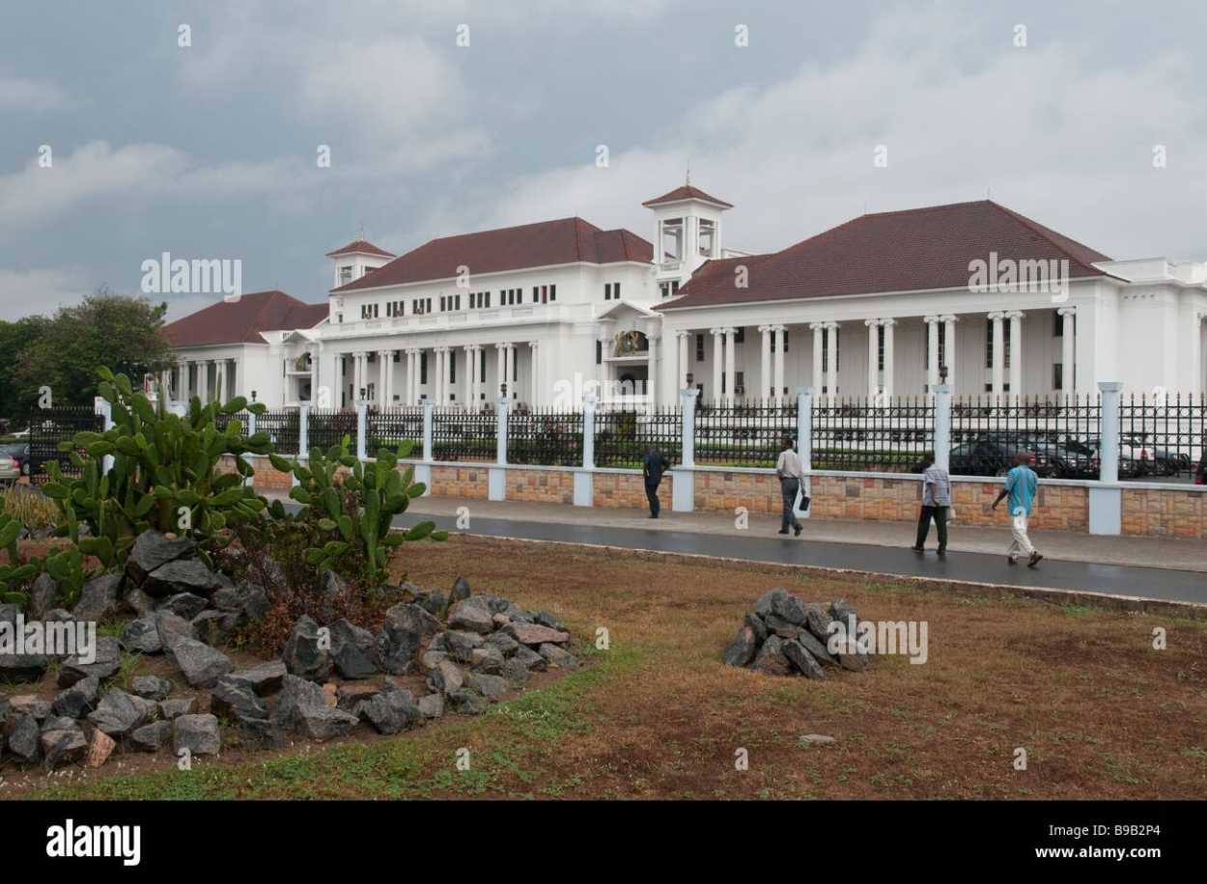
Jurisdictional Tour: Ghana
Legal Framework
Ghana's ADR Act, 2010 (Act 798) provides a modern statutory base for arbitration that:
Incorporates international best practices while respecting local context
Establishes clear procedures for arbitrator appointment and challenge
Provides robust enforcement mechanisms for arbitral awards
Creates a supportive judicial environment for arbitration
The Ghanaian courts have increasingly supported ADR uptake, enhancing the credibility of the process and encouraging parties to consider arbitration as a viable dispute resolution method.
Ghana's emerging arbitration framework creates opportunities to nominate West African arbitrators with relevant expertise in regional disputes.
Ghana represents an emerging arbitration hub in West Africa, with significant potential to contribute diverse arbitrators with expertise in sectors vital to the region's economy, including natural resources, infrastructure, and cross-border trade.
Notes:
“Supportive ADR framework and regional expertise in natural resources/infrastructure. Value: parties from West Africa often expect contextual understanding; nominate accordingly.” If rushed: “Leverage regional expertise for context.” Transition: “South Africa.”

Slide 13
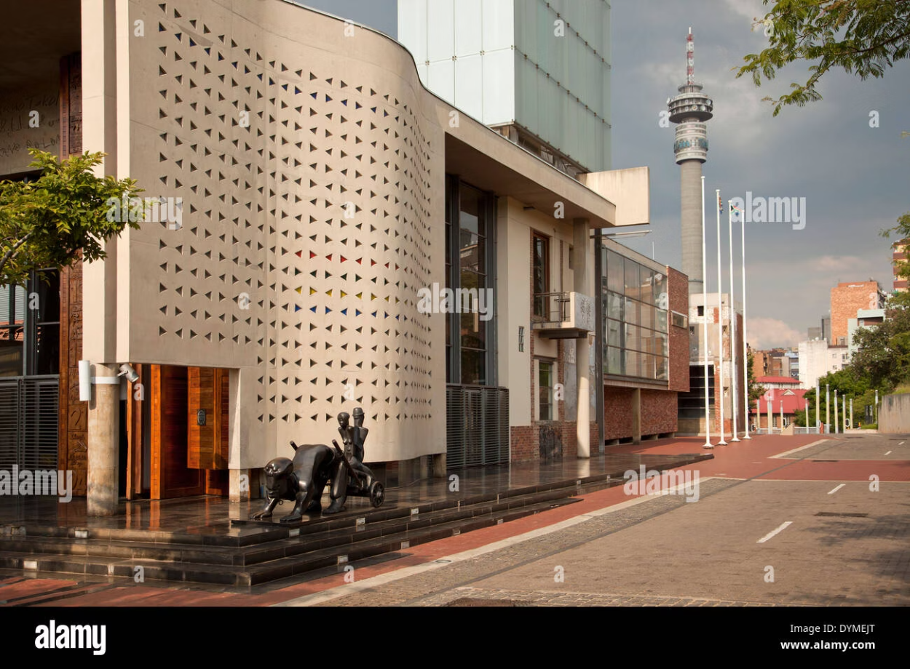
Jurisdictional Tour: South Africa
Legislative Framework
South Africa's International Arbitration Act, 2017:
Incorporates the UNCITRAL Model Law, providing a familiar framework for international users
Gives robust enforcement mechanisms aligned with international best practice
Establishes clear procedures for arbitrator appointment that can facilitate diversity
Modernizes South Africa's arbitration regime, increasing its appeal as a seat
South Africa's diverse local expertise in mining, competition, ESG, and other sectors should be leveraged for international panels, bringing valuable industry-specific knowledge to disputes.
South Africa's modernized arbitration framework aligns with international standards while maintaining awareness of regional concerns.
South Africa offers a unique combination of developed legal infrastructure, diverse expertise, and understanding of both common law and civil law traditions—making its arbitrators valuable additions to international tribunals dealing with complex cross-border disputes.
Notes:
“Deep bench in mining/competition/ESG. Cross-tradition (common/civil influences) improves comparative reasoning. Useful where regulatory nuance is key.” If rushed: “Cross-tradition strength helps ESG/mining.” Transition: “Hong Kong.”

Slide 14
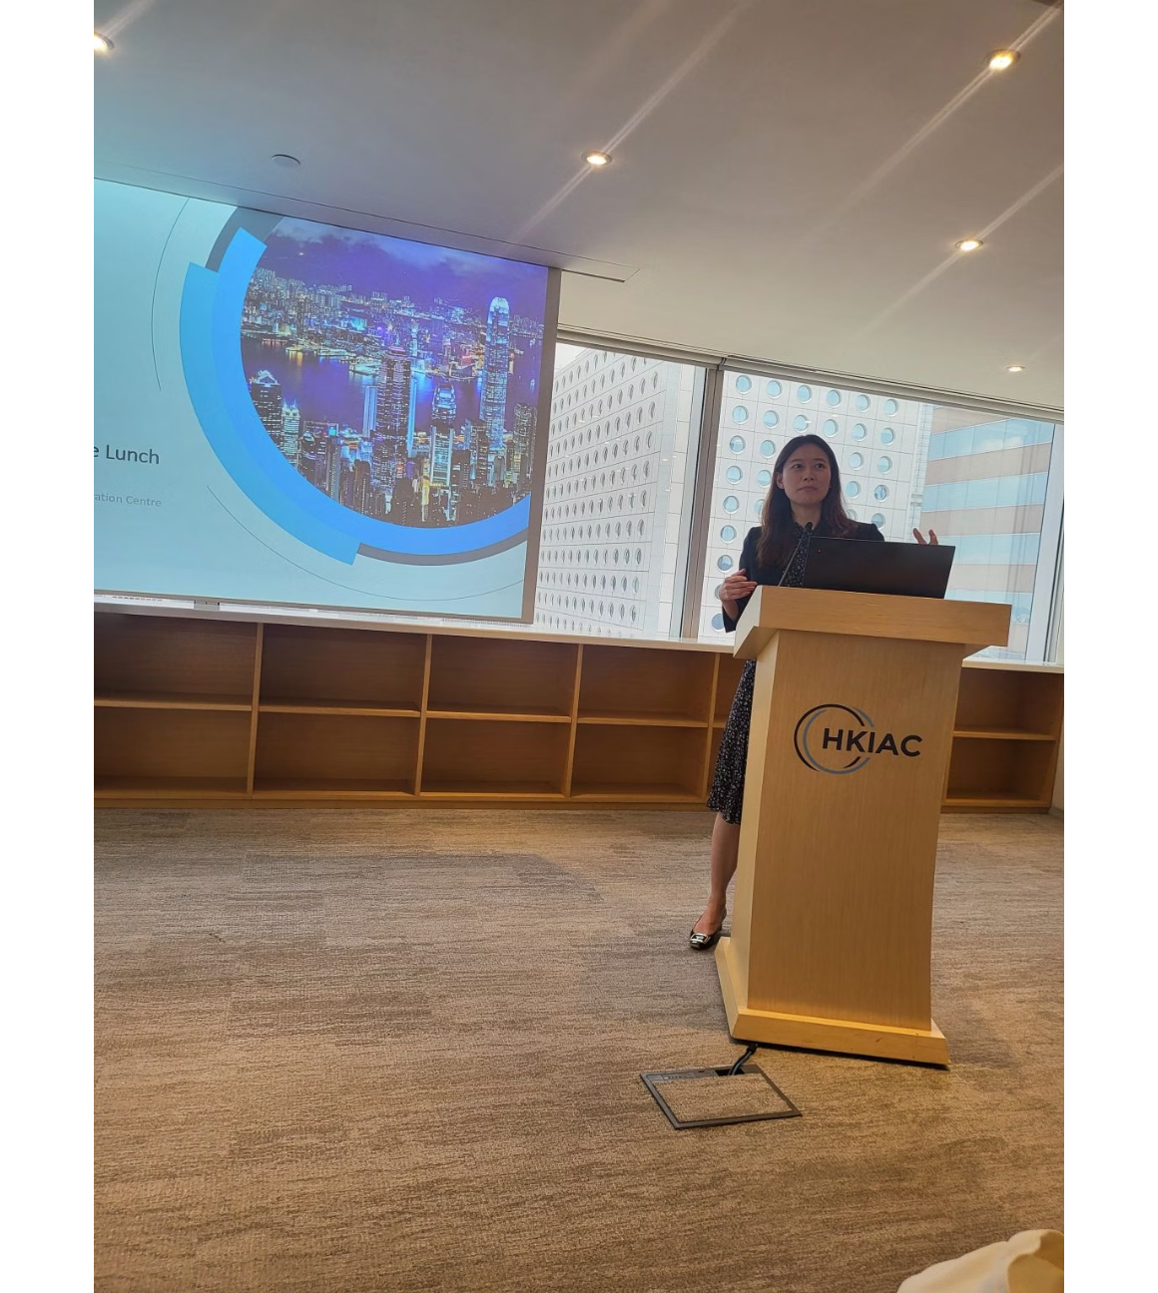
Jurisdictional Tour: Hong Kong
Progressive Framework
Hong Kong's Arbitration Ordinance (Cap. 609):
Aligns closely with the UNCITRAL Model Law
Unifies the domestic and international arbitration regimes
Provides strong judicial support for arbitration
Enshrines confidentiality protections
Institutional practice at HKIAC demonstrates sophisticated multi-language, multi-contract case management—ideal for broadening Asia-focused arbitrator slates.
Hong Kong's position as a bridge between East and West makes it an important source of arbitrators who understand both Asian and Western legal traditions and business practices.
Hong Kong maintains its status as a leading arbitration hub despite political challenges, continuing to offer world-class facilities and expertise.
Hong Kong arbitrators bring valuable linguistic capabilities, cross-cultural understanding, and familiarity with both common law principles and Asian business practices—attributes that enhance tribunal diversity in substance as well as form.
Notes:
“Bilingual proceedings, robust case management, proximity to Mainland practices. Mixed panels here often resolve language and practice gaps efficiently.” If rushed: “Bilingual + East-West bridge.” Transition: “India.”

Slide 15

Jurisdictional Tour: India
Progressive Arbitration Framework
India's Arbitration and Conciliation Act, 1996 (as amended) provides a comprehensive framework:
Section 11
Court supervision of appointments, ensuring appropriately qualified arbitrators
Section 12(5)
Stringent independence requirements with reference to the Fifth and Seventh Schedules
Section 18
Equal treatment guarantee, supporting balanced tribunal composition
Sections 34/48
Challenge and enforcement pathways that consider tribunal composition
This framework provides ample doctrinal support to insist on broad-based tribunal constitution, reinforced by the Supreme Court's progressive jurisprudence on arbitrator independence and impartiality.
Notes:
“Strong architecture under the Arbitration and Conciliation Act. Leverage Section 11 (appointments), Section 12(5) (independence), and Section 18 (equality) to justify broad, qualified slates.” If rushed: “Use S.11/S.12(5)/S.18 to widen slates.” Transition: “What users are saying.”

Slide 16

What the Data Tells Us: User Perspectives
White & Case / Queen Mary 2021 Survey Findings
This authoritative survey revealed several key insights:
Visible progress on gender diversity, but much less on geographic, age, cultural, and ethnic diversity
Users identify a significant role for institutions and counsel in addressing the pipeline problem
Call for visibility-building initiatives including education in emerging jurisdictions, mentorships, and speaking opportunities for less-experienced arbitrators
Recognition that diverse tribunals deliver higher quality decisions by bringing multiple perspectives to complex issues
Users increasingly recognize diversity as a quality indicator, not merely a representation issue.
These insights should motivate practical steps: develop and publish diverse-shortlist policies, commit to regular audits, and create structured opportunities for new arbitrators to gain visibility and experience.
Notes:
Data, transparency, and reputational incentives. Your draft cites the White & Case 2021 Survey: users see most progress in gender diversity; far less in geographic, age, cultural and ethnic diversity; they assign a big role to institutions and counsel; and they emphasise visibility-building (education in emerging jurisdictions, mentorships, speaking slots). Quote those figures on a slide and invite counsel to adopt an internal policy: diverse shortlist as default; annual audit of who was actually nominated; publish the policy.
“Users want transparent data, broader shortlists, and fewer repeats. They value sector knowledge, language skills, and availability as much as fame.” If rushed: “Data + slates + availability > fame.” Transition: “Transparency tools help.”

Slide 17
Transparency Projects: Building Confidence
Evidence-Based Nomination Confidence
Emerging transparency initiatives are transforming how parties select arbitrators:
Arbitrator Intelligence
Institutional Rosters
Diversity Databases
Aggregates feedback and data on arbitrator performance, providing an evidence base for nominations
Increasingly include detailed information on arbitrator experience, expertise, and approach
Compile information on qualified arbitrators from underrepresented groups to facilitate identification
These projects reduce perceived "first-time" risk while preserving quality and neutrality. They enable parties to nominate outside the usual suspects with greater confidence by providing objective data on capabilities and approach.
Transparency tools transform diversity from an aspirational goal to a practical reality by addressing the information asymmetry that often drives parties toward familiar names.
Notes:
Tools that reduce perceived risk. Arbitrator Intelligence builds a feedback and award database to make first-time selections evidence-based, tackling the “we don’t know them” objection. Use it live: show what a profile looks like and how it supplements institutional vetting.
“Richer rosters and diversity databases reduce first-timer risk. Share anonymised procedural orders and publication lists to show style, speed, and sector fit.” If rushed: “Evidence beats hunches in nominations.” Transition: “Perspective from women arbitrators.”

Slide 18

Female Arbitrator Perspective
Unique Challenges and Contributions
Female arbitrators navigate distinct professional realities:
Often face higher scrutiny of qualifications despite equivalent expertise
May encounter implicit bias in evaluation of demeanor and authority
Bring different lived experiences to assessment of witness credibility and fact patterns
Often develop innovative case management techniques that benefit all parties
Research shows that mixed-gender tribunals tend to deliberate more thoroughly and consider a wider range of perspectives—enhancing the quality of the decision-making process and the resulting award.
Female arbitrators bring valuable perspectives that may otherwise be absent from tribunal deliberations.
The ERA Pledge (Equal Representation in Arbitration) has made significant progress in raising awareness and increasing appointments of female arbitrators—demonstrating the impact of focused initiatives when supported by institutions and counsel.
Notes:
IV. Female-arbitrator perspective within doctrine (6–7 minutes)
“Higher scrutiny is real. Mixed-gender panels tend to deliberate more thoroughly. Intentional pairing accelerates trust without compromising quality.” If rushed: “Pairing drives quality and trust.” Transition: “Digital inclusion.”

Slide 19




The Female Arbitrator Experience: Challenges and Strategies
Navigating Gender-Specific Barriers
Female arbitrators face distinct challenges requiring targeted strategies:
Visibility Challenges
Work-Life Balance
Women often report difficulty gaining the visibility necessary for appointments
The demanding schedule of international arbitration can present challenges for those with caregiving responsibilities
Strategic networking, publications, and speaking engagements can help overcome this barrier
Flexible hearing schedules and remote participation options can mitigate these issues
Implicit Bias
Success Strategies
Research shows women may face higher standards and greater scrutiny of their qualifications
Developing sector-specific expertise, participating in women's arbitration networks, and seeking institutional appointments have proven effective
Structured selection criteria and blind CV reviews can help combat these biases
The Equal Representation in Arbitration Pledge has made significant progress in raising awareness and increasing appointments of female arbitrators—demonstrating the impact of focused initiatives.

Slide 20
Digital Inclusion in the Post-Pandemic Era
Opportunities
Challenges
Virtual hearings have lowered geographical barriers to participation
Bandwidth inequities can create disadvantages for participants in certain regions
Remote proceedings reduce travel costs that previously limited arbitrator diversity
Time-zone burdens may fall disproportionately on arbitrators from certain areas
Technology enables participation of experts and arbitrators from underrepresented regions
Technology access varies significantly across regions and economic circumstances
Hybrid formats allow flexible tribunal constitution that might otherwise be impractical
Digital literacy remains uneven, potentially limiting effective participation
The solution is not to "go back" to exclusively in-person proceedings, but to standardise hybrid approaches: remote case management conferences, online expert conferencing, witness examination with translation capacity, and budget lines for digital inclusion to prevent new forms of exclusion.
Notes:
V. The pandemic’s legacy and digital inclusion (3–4 minutes)
Your notes recognise that virtual hearings widened access but exposed infrastructure inequities. Keep the hybrid toolkit (remote CMCs, witness conferencing, expert “hot-tubbing” online), but budget for digital inclusion so we don’t swap one barrier for another.
“Virtual hearings lower cost barriers but add bandwidth/time-zone burdens. Bake time-zone rotation, tech standards, and accessibility into PO1.” If rushed: “Write fairness into PO1.” Transition: “Now, the playbook.”

Slide 21

Operational Playbooks
Practical Strategies for Key Stakeholders
Moving from aspiration to implementation requires concrete actions from all participants in the arbitral process. The following playbooks provide practical guidance for each stakeholder group.
Meaningful change requires coordinated effort across the arbitration ecosystem, with each actor taking responsibility for enhancing diversity within their sphere of influence.
Notes:
VI. What to do on Monday morning (5 minutes)
Institutional side: publish granular stats by gender, region, appointing channel, language, and repeat appointments; disclose names where policy allows; rotate “first appointments” under paired-panel models.
Counsel side: adopt a written diverse-shortlist policy; maintain an internal tracker by sector/language; use Arbitrator Intelligence and institutional rosters to widen the pool; document your reasoning in nomination memos.
Arbitrator side: publish precise bios with sector and language granularity; state measured availability; share redacted procedural orders and case-management innovations where permissible.
Cohort-building: micro-mentorships that produce work (shadowing on POs; red-lining awards; co-teaching segments); conference programming that gives first-time speakers the mic—your survey’s respondents explicitly rate this.

Slide 22
Operational Playbook: Counsel
1
2
Diverse Shortlists by Default
Nomination Memos
Make diverse candidate consideration the standard practice, not an exception
Develop structured nomination memoranda that record sector fit, language capabilities, and independence analysis
Include candidates from underrepresented regions, genders, and backgrounds in every selection process
Apply the IBA Guidelines colour lists systematically to all candidates
Set internal policies requiring consideration of diverse candidates
Document selection rationale to ensure decisions are based on qualifications, not familiarity
3
4
Internal Trackers
First-Time Nominations
Maintain an internal dashboard tracking nominations by sector, language, region, and repeat-appointment rate
Include at least one genuinely first-time candidate with precise expertise required in each selection process
Review data regularly to identify patterns and opportunities for improvement
Pair less experienced arbitrators with seasoned chairs to mitigate perceived risk
Share aggregated statistics with clients to demonstrate commitment to diversity
Utilize tools like Arbitrator Intelligence to identify qualified new candidates
Counsel serve as critical gatekeepers in the arbitrator selection process—their commitment to diversity can drive systemic change throughout the arbitration ecosystem.
Notes:
Slide 23 — Playbook: Counsel (Part I)
Script: “Always propose at least three qualified, diverse nominees with sector/language fit. Provide a nomination memo mapping IBA color lists, conflicts, and availability.” If rushed: “Three qualified nominees + memo.” Transition: “Counsel (Part II).”
Slide 24 — Playbook: Counsel (Part II)
Script: “Track repeat-rates internally; aim to reduce over-concentration. Pair one genuinely first-time arbitrator with a seasoned chair; assure clients with documented criteria.” If rushed: “Reduce repeats, pair first-timers.” Transition: “Institutions’ role.”

Slide 23




Operational Playbook: Institutions
Publish Disaggregated Statistics
Implement Pairing Strategies
Release detailed data on appointments including gender, region, appointing channel (party vs institution vs co-arbitrator), language capabilities, and repeat-appointment rates
Use strategic pairing to de-risk first-time appointments by combining experienced chairs with newer co-arbitrators
Develop mentoring relationships between established and emerging arbitrators
Track year-on-year progress against diversity metrics
Enhance Transparency
Broaden Rosters
Disclose arbitrator names where policy allows to widen discoverability
Actively recruit qualified candidates from underrepresented groups for institutional rosters
Publish redacted decisions on arbitrator challenges to build understanding of standards
Create clear pathways for newer arbitrators to join panels and gain experience
Institutions possess unique powers to shape the arbitrator marketplace through their appointment practices, data collection, and policies—making them powerful agents for enhancing diversity.
Notes:
Slide 25 — Playbook: Institutions
Script: “Publish disaggregated stats yearly. Use pairing models, broaden rosters actively, and—where policy allows—give brief reasons for appointments to build trust.” If rushed: “Stats + pairing + reasons.” Transition: “Arbitrators’ role.”

Slide 24

Operational Playbook: Arbitrators
For Established Arbitrators
For Emerging Arbitrators
Mentor emerging arbitrators from underrepresented groups
Publish precise bios detailing industry verticals, procedural strengths, and languages
Nominate diverse co-arbitrators when serving as chair
State measured availability to demonstrate commitment
Support transparency initiatives by sharing redacted procedural orders where permissible
Participate in visibility-building activities such as writing, speaking, and institutional committees
Advocate for diversity in speaking engagements and professional activities
Develop demonstrable expertise in specific sectors or issue areas
Visibility is not vanity; it is how appointing parties evaluate fit. Arbitrators at all career stages have important roles to play in enhancing diversity and inclusion in international dispute resolution.
Notes:
Slide 26 — Playbook: Arbitrators (Established)
Script: “Mentor emerging arbitrators, nominate diversely when asked, and be explicit about availability windows to reduce scheduling bias.” If rushed: “Mentor, nominate, state availability.” Transition: “Arbitrators (Emerging).”
Slide 27 — Playbook: Arbitrators (Emerging)
Script: “Publish a precise bio (sector, language, writing samples), show procedural discipline (PO templates), and take expert/tribunal-secretary roles as visibility pathways.” If rushed: “Precise bio + PO style + pathways.” Transition: “Clients matter too.”

Slide 25

Client Role: Moving Beyond Symbolism
Client-Driven Diversity Initiatives
Corporate and governmental clients can enhance diversity through:
Including diversity expectations in outside counsel guidelines
Requesting diverse shortlists for all arbitrator nominations
Tracking and reporting on diversity in their dispute resolution processes
Supporting the appointment of qualified first-time arbitrators
Considering diversity when drafting arbitration clauses and selecting institutions
Your "Novel Solution" section rightly puts the onus on all actors—including clients—and stresses that symbolism without structural change is not enough.
In-house counsel can drive change by setting clear expectations about diversity in tribunal formation.
Clients hold significant power to influence arbitrator selection practices through their instructions to counsel and choice of institutions—their active engagement is essential for meaningful progress.
Notes:
Slide 28 — Playbook: Clients / In-House
Script: “Set expectations in outside-counsel guidelines: diverse shortlists, evidence-based memos, openness to first-timers where sector fit is exact. Review repeat-rates.” If rushed: “Write it into OCGs.” Transition: “Comparative approaches.”

Slide 26

Comparative Institutional Approaches
ICC
LCIA
SIAC
HKIAC
Publication of Statistics
Transparency in Appointments
Diversity Initiatives
Institutions vary significantly in their approaches to diversity enhancement, with some focusing on gender balance, others on regional representation, and still others on age diversity and first-time appointments.
The most effective institutional strategies combine clear diversity policies, transparent reporting, active roster development, and strategic pairing of experienced and newer arbitrators.
Notes:
Slide 29 — Comparative Institutional Approaches
Script: “Best-practice blend: clear policy, transparent reporting, pairing mechanisms, and active roster development—measured against caseload composition.” If rushed: “Policy + data + pairing.” Transition: “Pipeline reality.”

Slide 27

The Pipeline Challenge: Building for the Future
Long-Term Pipeline Development
Sustainable diversity requires attention to the pipeline of future arbitrators:
Educational initiatives in emerging arbitration jurisdictions
Scholarships and mentoring programs for underrepresented groups
Speaking and writing opportunities for rising arbitration practitioners
Tribunal secretary roles as pathways to arbitrator appointments
Young arbitrator forums and networking opportunities
The arbitrators of tomorrow are developing their expertise today—investment in pipeline development will yield long-term benefits for the field.
Pipeline development requires coordinated effort from universities, arbitral institutions, law firms, and experienced arbitrators to identify, nurture, and promote diverse talent that will shape the future of international dispute resolution.
Notes:
Slide 30 — Pipeline & Pathways
Script: “Universities, institutions, firms, and arbitrators must co-invest: scholarships, clinics, tribunal-secretary routes, and young-arbitrator forums.” If rushed: “Invest across the pipeline.” Transition: “Cultural intelligence.”

Slide 28

Cultural Intelligence in Arbitral Proceedings
Beyond Representation: Cultural Competence
Diversity enhances tribunal effectiveness through cultural intelligence:
Understanding of how cultural contexts shape contract interpretation
Recognition of varying approaches to witness testimony across cultures
Awareness of differing attitudes toward authority, directness, and conflict
Appreciation of distinct communication styles and their impact on proceedings
Sensitivity to how language barriers affect party participation
Culturally diverse tribunals are better equipped to navigate these complexities, avoiding misunderstandings that can lead to flawed decisions or enforcement difficulties.
Cultural intelligence is not merely about representation—it directly impacts the quality of fact-finding and procedural fairness.
True diversity goes beyond demographics to encompass the substantive cultural competence that enhances tribunal effectiveness in cross-border disputes involving parties from different legal traditions and business cultures.
Notes:
Slide 31 — Cultural Intelligence
Script: “Diversity improves reading of commercial practice, hierarchy, silence, and face-saving—all of which shape witness demeanor and settlement dynamics.” If rushed: “Better cultural read = better justice.” Transition: “Case studies of initiatives.”

Slide 29



Case Study: Successful Diversity Initiatives
Africa Arbitration Academy
ArbitralWomen
Young ICCA
Created a pipeline of African arbitrators through:
Advanced gender diversity through:
Addressed age diversity through:
Networking and mentoring programs
Mentoring program pairing emerging and established arbitrators
Training programs for practitioners across the continent
Database of qualified female practitioners
Skills workshops and scholarship opportunities
Mentorship by established international arbitrators
Collaboration with institutions on diversity policies
Publication opportunities for young practitioners
Visibility opportunities at major arbitration events
Regular reporting on gender statistics
Result: Female arbitrator appointments have more than doubled in the past decade
Global network of future arbitration leaders
Database of qualified African practitioners
Result: Created pathways for younger practitioners to gain visibility and experience
Result: Significant increase in appointments of African arbitrators in regional disputes
These initiatives demonstrate that targeted, structured approaches to specific aspects of diversity can yield measurable results—providing models that can be adapted and scaled across the arbitration community.
Notes:
Slide 32 — Case Study: AAAfrica/ArbitralWomen/Young ICCA
Script: “Targeted training + mentoring + visibility yields measurable appointments. Copy what works, localise to sector/region, and scale.” If rushed: “Copy, localise, scale.” Transition: “The business case.”

Slide 30

The Business Case for Diversity
Beyond Moral Arguments: Performance Enhancement
Research consistently demonstrates that diverse groups make better decisions:
20%
87%
35%
Performance Improvement
Error Reduction
Innovation Increase
Studies show diverse teams outperform homogeneous teams by up to 20% in decision-making tasks
Diverse groups are more likely to identify and correct errors in reasoning and fact assessment
Teams with diverse backgrounds generate more innovative solutions to complex problems
For parties and counsel, diverse tribunals offer tangible benefits: reduced groupthink, more thorough deliberation, greater scrutiny of assumptions, and awards that reflect consideration of multiple perspectives—all contributing to better outcomes and enhanced legitimacy.
Notes:
Slide 33 — Business Case for Diversity
Script: “Diverse teams detect errors better and innovate more. In arbitration: tighter fact-finding, stronger reasoning, awards that travel—fewer set-asides, smoother recognition.” If rushed: “Quality up, risk down.” Transition: “Language matters.”

Slide 31

Linguistic Diversity and Procedural Fairness
Language as a Diversity Factor
Linguistic diversity impacts arbitral proceedings in several ways:
Parties may experience disadvantages when proceedings occur in languages they do not master
Translation and interpretation can introduce distortions in testimony and argument
Slide 34 — Linguistic Diversity
Script: “Panels with relevant languages reduce translation distortion and cost. Language is a fairness decision linked to equal treatment.” If rushed: “Language = fairness.” Transition: “Generations.”
Cultural nuances embedded in language may be lost in translation
Document-heavy cases become more complex and costly when multiple languages are involved
Tribunals with relevant language skills can directly access evidence without intermediation
Arbitrators with multilingual capabilities bring significant value to international disputes, enhancing both efficiency and fairness.
Language capabilities directly impact procedural fairness and equal access to justice in international proceedings.
When constituting tribunals, language skills should be considered not merely as practical tools but as substantive contributions to procedural fairness and equal treatment of the parties—principles enshrined in Article 18 of the Model Law.
Notes:
Slide 34 — Linguistic Diversity
Script: “Panels with relevant languages reduce translation distortion and cost. Language is a fairness decision linked to equal treatment.” If rushed: “Language = fairness.” Transition: “Generations.”

Slide 32

Generational Diversity: The Next Frontier
Age Diversity Benefits
Including arbitrators from different generations brings several advantages:
Combines fresh perspectives with established experience
Enhances understanding of evolving commercial practices
Improves technological adaptation in proceedings
Creates natural knowledge transfer opportunities
Ensures continuity in the field through generational transition
The significant age gap between the average commercial arbitrator and the average in-house counsel or corporate client can create disconnects in expectations and approaches.
As Dr Osei Bonsu Dickson noted in his invitation, "Modern arbitration thrives on diversity—of culture, of thought, of gender, race and even of approach."
Generational diversity initiatives such as the Young ICCA Mentoring Programme and institutional "shadow" schemes are creating pathways for younger practitioners to gain experience and visibility—essential for sustainable diversity in the field.
Notes:
Slide 35 — Generational Diversity
Script: “Bridges tech adoption and communication styles with in-house teams; supports pragmatic case management and early settlement windows.” If rushed: “Cross-gen = smoother management.” Transition: “Accessibility.”

Slide 33
Disability Inclusion: An Overlooked Dimension
Accessibility in Arbitration
The arbitration community has paid insufficient attention to disability inclusion:
Physical Accessibility
Digital Inclusion
Procedural Adaptations
Hearing venues must be accessible to participants with mobility impairments
Virtual hearings must consider accessibility needs, including screen readers and captioning
Flexible scheduling may be necessary to accommodate health-related needs
Travel requirements can create barriers for arbitrators with certain disabilities
Communication methods may need adjustment for participants with sensory disabilities
Electronic document formats should be accessible to all participants
The rise of remote and hybrid proceedings presents an opportunity to enhance inclusion for arbitrators and practitioners with disabilities—removing physical barriers while creating new possibilities for participation.
Embracing disability inclusion not only widens the pool of available talent but also demonstrates the arbitration community's commitment to true diversity in all its dimensions.
Notes:
Slide 36 — Disability Inclusion
Script: “Physical access, captioning, screen-reader-friendly bundles, and flexible schedules. Hybrid hearings are an opportunity to standardise accessibility.” If rushed: “Bake accessibility into PO1.” Transition: “Cognitive styles.”

Slide 34

Cognitive Diversity: Beyond Demographics
The Value of Different Thinking Styles
Cognitive diversity—variation in how people think, process information, and approach problems—may be the most valuable form of diversity for decision-making:
Different analytical frameworks lead to more thorough evaluation of evidence
Varied problem-solving approaches generate more comprehensive solutions
Diverse thinking styles help identify blind spots in reasoning
Complementary cognitive strengths enhance tribunal effectiveness
Mixed thinking patterns improve adaptation to novel situations
Demographic diversity often serves as a proxy for cognitive diversity, but the two are not perfectly aligned—both require intentional consideration in tribunal formation.
Research in decision science consistently shows that cognitively diverse groups produce better-reasoned decisions, particularly in complex analytical tasks.
A truly effective tribunal combines various thinking styles—systematic and intuitive, detail-oriented and big-picture, risk-averse and innovative—creating a decision-making environment where assumptions are questioned and reasoning is rigorous.
Notes:
Slide 37 — Cognitive Diversity
Script: “Balance systematic and intuitive decision-making; appoint panels that bring both analytical rigour and commercial sense.” If rushed: “Blend thinking styles.” Transition: “Geography.”

Slide 35
Geographical Diversity: Beyond North-South Divides
Regional Representation Matters
Geographical diversity remains significantly underdeveloped compared to gender diversity:
60%
12%
4%
European Dominance
Asia-Pacific Share
African Representation
European arbitrators continue to dominate international appointments despite global caseloads
Only 12% of arbitrators come from Asia-Pacific despite the region's economic significance
African arbitrators remain severely underrepresented at just 4% of international appointments
Regional diversity brings essential perspectives on:
Local commercial practices and business customs
Regulatory environments and compliance expectations
Cultural contexts that shape contract performance
Enforcement realities in different jurisdictions
Geographic diversity enhances both the quality of decision-making and the legitimacy of the arbitral process across regions—particularly important as arbitration continues to globalize.
Notes:
Slide 38 — Geographical Diversity
Script: “Regional familiarity with regulators, trade practices, and enforcement culture prevents naive procedural orders and improves remedy design.” If rushed: “Local insight, global enforceability.” Transition: “Measure what matters.”

Slide 36

Measurement and Accountability
Creating Accountability Mechanisms
Effective diversity enhancement requires robust measurement:
Define clear, measurable diversity metrics across multiple dimensions
Establish regular reporting cycles with consistent methodology
Disaggregate data to identify specific areas requiring attention
Set progressive targets with realistic timeframes
Create accountability for progress at institutional and firm levels
Publish results to enable comparison and drive competition
The Diversity Dashboard concept—a standardized reporting framework adopted across institutions—would enable meaningful comparison and accelerate progress through healthy competition.
"What gets measured gets managed"—transparency drives progress through accountability.
Transparency serves not only accountability but also provides essential data for research on the impact of diversity on arbitral outcomes—building the empirical case for inclusion beyond moral arguments.
Notes:
Slide 39 — Measurement & Accountability
Script: “What gets measured gets managed. Push for a cross-institution ‘Diversity Dashboard’ with gender, region, language, appointing channel, and repeat-rates—annually.” If rushed: “Publish disaggregated stats.” Transition: “Draft for it.”

Slide 37
The Contractual Foundation: Drafting for Diversity
Embedding Diversity at the Contract Stage
Parties can proactively support diversity through thoughtful contract drafting:
Institutional Selection
Appointment Mechanisms
Diversity Clauses
Choose institutions with strong diversity track records and policies
Design appointment procedures that encourage consideration of diverse candidates
Include express language encouraging diversity in tribunal composition
Consider institutions that publish diversity statistics and set diversity targets
Specify consideration of diversity factors while respecting party autonomy
Avoid mechanisms that concentrate appointment power in a single party
Sample clause: "The parties agree that, when selecting arbitrators, they will consider qualified candidates of diverse backgrounds, including gender, nationality, age, and professional experience, with the aim of constituting a tribunal that reflects the international character of the transaction."
While such clauses are not legally binding, they establish expectations and provide a basis for diversity discussions during the appointment process.
Notes:
Slide 40 — Contractual Foundations
Script: “Draft clauses that steer to institutions with track records; avoid single-party control of lists; consider soft diversity wording to set expectations early.” If rushed: “Clause-level nudges work.” Transition: “Experts as a bridge.”

Slide 38

Promoting Diversity Through Expert Appointments
Expert Roles as Diversity Pathways
Expert appointments provide valuable opportunities to enhance diversity:
Parties have more flexibility in expert selection than in arbitrator appointments
Expert roles offer visibility and credibility that can lead to arbitrator appointments
Topic-specific expertise often creates opportunities for specialists from underrepresented groups
Expert witness experience builds familiarity with arbitral procedures
Tribunal-appointed experts gain direct exposure to arbitrators and proceedings
Expert appointments can serve as stepping stones for practitioners from underrepresented groups, building credentials and relationships that facilitate future arbitrator appointments.
Expert roles often draw from more diverse professional backgrounds, creating natural opportunities for inclusion.
Counsel can advance diversity by intentionally considering underrepresented groups when selecting party-appointed experts, while tribunals can do the same when appointing tribunal experts—creating valuable exposure opportunities.
Notes:
Slide 41 — Experts as Pathways
Script: “Expert roles can showcase sector fit and hearing craft. Experts often transition to arbitrator appointments when performance is visible.” If rushed: “Use experts to build pipelines.” Transition: “Sector nuance.”

Slide 39
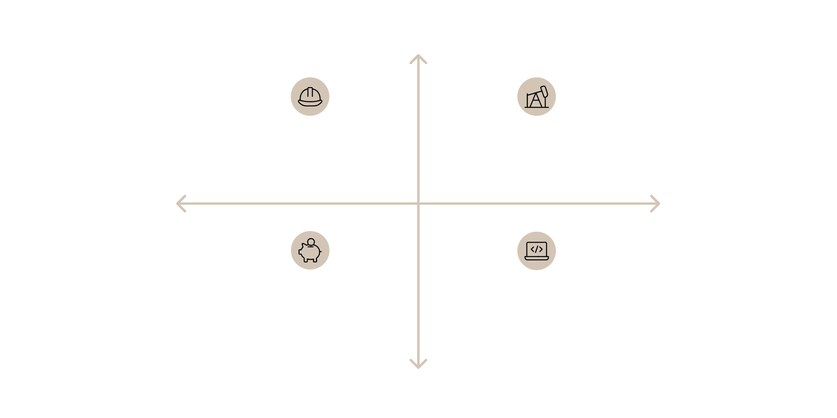




Sector-Specific Diversity Challenges
High structural barriers
Construction: Gender & Age gaps
Energy: Geographic & Background barriers
Low sector inertia
High sector inertia
Finance: Gender & Background homogeneity
Technology: Age & Geographic skew
Low structural barriers
Notes:
Different industry sectors present unique diversity challenges and opportunities:
Construction: Historically male-dominated field with technical expertise barriers but opportunities for regional diversity
Energy: Strong geographic concentrations in expertise but increasingly diverse talent pool in renewable energy
Finance: Growing gender diversity but concentration in traditional financial centers
Technology: Better age diversity but geographic concentration in certain innovation hubs
Sector-specific diversity initiatives can address these unique challenges, drawing on existing diversity within each industry to enhance tribunal composition in related disputes.
Script: “Construction/energy: schedule and tech-heavy—pairing helps. Finance: speed and confidentiality—availability matters. Tech/IP: language and agile case management—hybrid competence essential.” If rushed: “Tailor slate to sector pain-points.” Transition: “Academia’s role.”

Slide 40

The Role of Academia in Enhancing Diversity
Academic Contributions to Diversity
Universities and academic institutions can enhance diversity through:
Inclusive arbitration curricula that feature diverse scholars and perspectives
Scholarship opportunities for students from underrepresented backgrounds
Research on diversity impacts on arbitral outcomes
Mooting competitions that develop skills in diverse student populations
Faculty appointments that reflect diversity in the field
Partnerships with arbitral institutions on diversity initiatives
Academic research provides the empirical foundation for diversity arguments, moving beyond moral appeals to demonstrate concrete benefits in arbitral quality and legitimacy.
Academic institutions shape the future arbitration landscape through their teaching, research, and thought leadership.
As Dr Osei noted in his invitation, CIMA's upcoming course brings together "an outstanding faculty" that "combines scholarship with practical insight"—exemplifying how academic excellence and diversity can reinforce each other.
Notes:
Slide 43 — Academia & Training
Script: “Diverse faculties, clinic models, moot coaching, and research on appointment data make tomorrow’s panels more representative and skilled.” If rushed: “Universities seed the pipeline.” Transition: “Intersectionality.”

Slide 41

Intersectionality in Arbitration
Beyond Single-Axis Thinking
Intersectionality—the overlapping of multiple identity dimensions—creates unique experiences that must be considered in diversity initiatives:
Compound Barriers
Unique Perspectives
Individuals with multiple underrepresented characteristics often face compounded obstacles to advancement
Intersectional identities generate distinct viewpoints that enhance decision-making quality
These perspectives may be particularly valuable in complex cross-cultural disputes
For example, women of colour encounter challenges distinct from those faced by white women or men of colour
Targeted Approaches
Effective diversity initiatives must address specific intersectional challenges
One-size-fits-all approaches often fail to address the needs of those at identity intersections
Sophisticated diversity strategies recognize and address intersectionality, moving beyond single-axis thinking to consider how multiple identity dimensions interact in the arbitration context.
Notes:
Slide 44 — Intersectionality
Script: “One-size-fits-all fails. Overlapping identities create compounded barriers. Design initiatives with multiple entry points: scholarships, mentorship, speaking slots, and transparent lists.” If rushed: “Multiple entry points win.” Transition: “Bring it home.”

Slide 42

The Path Forward: A Synthesis
The future of diversity in international arbitration depends on integrated action across multiple dimensions:
Immediate Actions
Long-Term Transformation
Implement diverse shortlists by default
Address pipeline challenges through education
Publish disaggregated appointment statistics
Change cultural norms around appointment "safety"
Leverage existing rules and guidelines
Integrate diversity into arbitration clauses
1
2
3
Medium-Term Initiatives
Develop standardized diversity reporting frameworks
Create structured mentoring programs
Establish pairing mechanisms for first-time arbitrators
Progress requires commitment from all stakeholders—institutions, counsel, arbitrators, clients, and academics—working in concert toward a more inclusive and representative arbitration system.
Notes:
Slide 45 — Path Forward & Close
Script: “Immediate: require diverse shortlists and publish basic stats. Medium: pairing and mentoring with reasons where possible. Long: pipeline investment and clause-level nudges. Diversity improves facts, law, legitimacy, and enforceability. The tools exist—the variable is our choices. Thank you.” If rushed: “Shortlists + stats now; pairing + pipeline next.” Transition to Q&A: “Happy to take questions.”

Slide 43
Conclusion: The Promise of Diversity
We began with a simple thesis: diversity is not optics—it is performance. The evidence and analysis presented confirm this fundamental truth.
"The future of dispute resolution will be decided by whether our tribunals can see what our parties see—across cultures, languages, industries, and legal traditions."
Diversity enhances international arbitration by:
Improving the quality of factual and legal analysis
Strengthening the legitimacy of the process across cultures
The tools for this transformation already exist in our legal architecture—from the Model Law to institutional rules, from disclosure requirements to challenge standards.
Enhancing the enforceability and acceptability of awards
Ensuring arbitration remains relevant in a globalized economy
Bringing fresh perspectives to evolving commercial challenges
What remains is consistent, intentional choice—by institutions in their appointments, by counsel in their nominations, by arbitrators in their availability, and by clients in their expectations. Together, these choices will shape a more diverse, inclusive, and effective international arbitration system.
Notes:
How should parties balance sector expertise against perceived "first-time" risk, and what pairing models actually work in practice?
Consider discussing the chair-wingman model, institutional pairing programs, and the role of detailed CV analysis in mitigating perceived risk.
Beyond gender, which data points should institutions publish to reflect true diversity—language, region, repeat rate by channel?
Explore the value of disaggregated data and standardized reporting frameworks across institutions.
What due-diligence artefacts (redacted POs, nomination memos) help GCs say yes to unfamiliar but well-matched candidates?
Discuss practical tools for building confidence in new arbitrator appointments while maintaining quality assurance.
These questions invite audience engagement with practical aspects of implementing diversity initiatives, moving beyond theoretical commitment to address real-world implementation challenges.

Slide 44

Call to Action
CIMA's Commitment to Diversity
As a 2025 Title Sponsor, the Center for International Mediators and Arbitrators (CIMA) in England & Wales actively supports diversity in international arbitration through:
Global Webinar Series
Educational Programmes
Connecting practitioners across key jurisdictions—India, Ghana, South Africa, and Hong Kong—to deepen comparative insights
Providing accessible training and certification opportunities for practitioners from diverse backgrounds
Research Initiatives
Supporting scholarship on diversity and inclusion in international dispute resolution
This webinar exemplifies CIMA's commitment to fostering dialogue and knowledge-sharing across jurisdictions and cultures, creating a more inclusive and representative arbitration community.
Notes:
Diversity is a performance variable—on facts, law, and legitimacy. We already have the doctrine, rules, and tools. Let’s make different choices at appointment, pairing, and reporting—and let the awards speak for themselves. Thank you.

