Slide 1
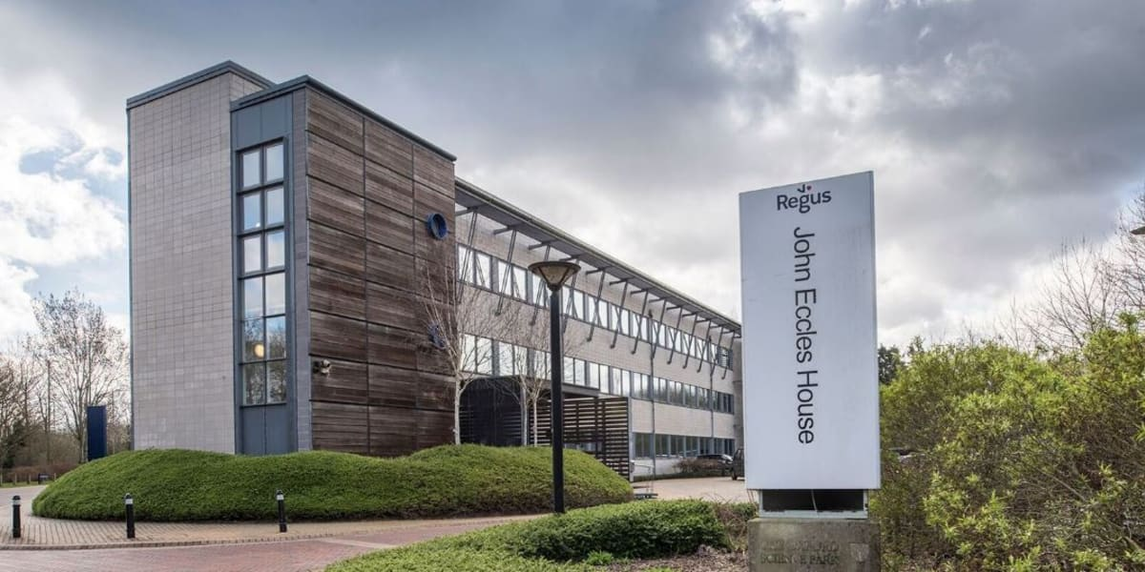
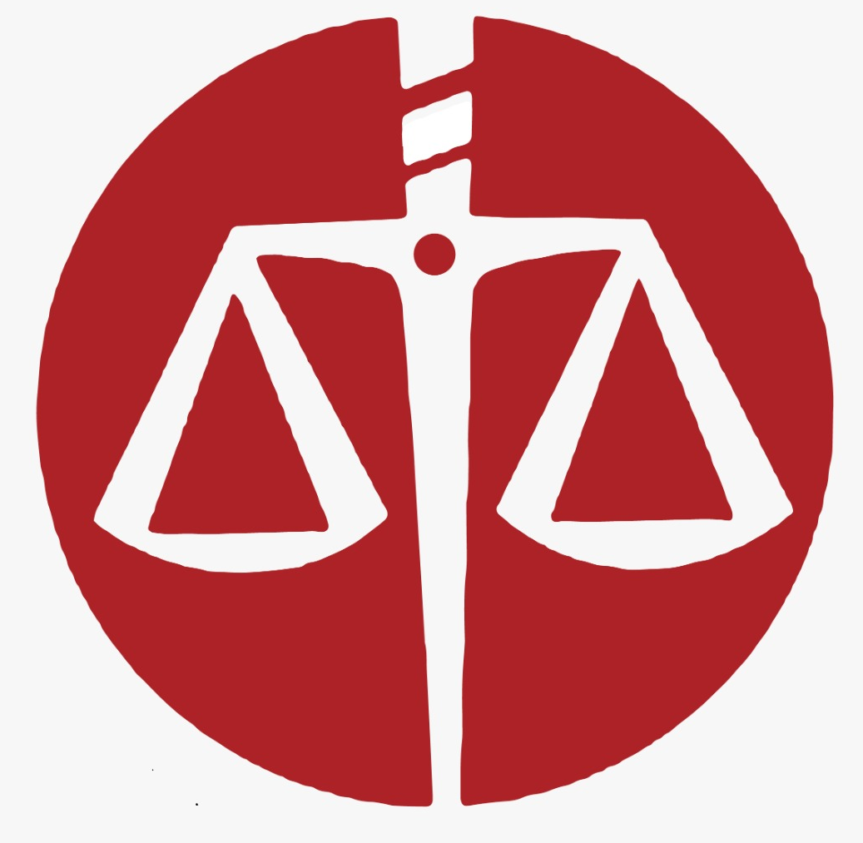
Board Governance: Discovering Commonalities
Challenges Faced by Diverse Boards: 5 Global Case Studies
Center for International Mediators and Arbitrators
ENGLAND & WALES
Dr Osei Bonsu Dickson FCIMArb

Slide 2
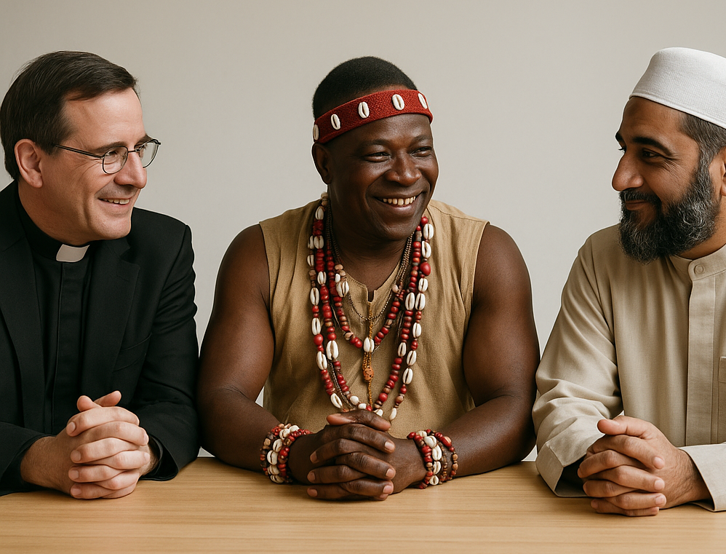
Center for International Mediators and Arbitrators
ENGLAND & WALES
Diversity
CONNECTING TO VALUES
PEACE IN DIVERSITY

Slide 3
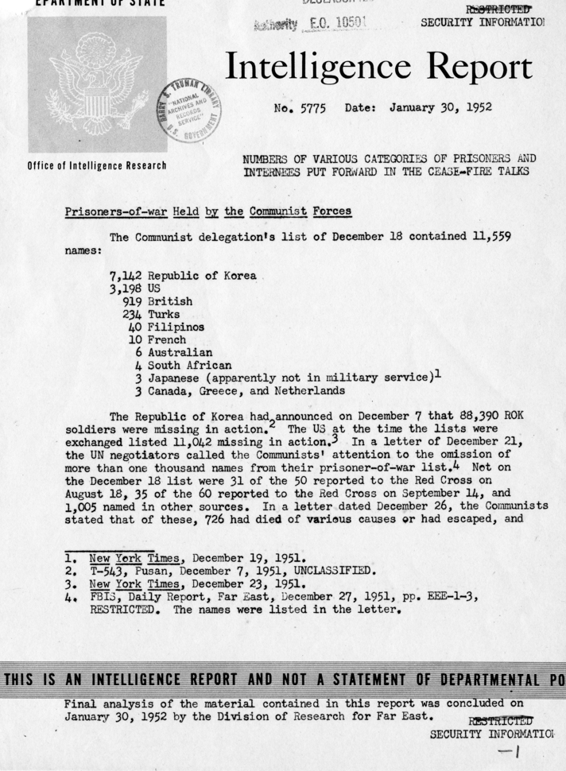
Center for International Mediators and Arbitrators
ENGLAND & WALES
Intelligence.
“Restricted” “Source Report” “Agents”
“Confidential” “Office of the President” “Threat Preparedness”
“Secret” “Early-Warning” “CARDING”
Dr Osei Bonsu Dickson FCIMArb 08/07/2025

Slide 4
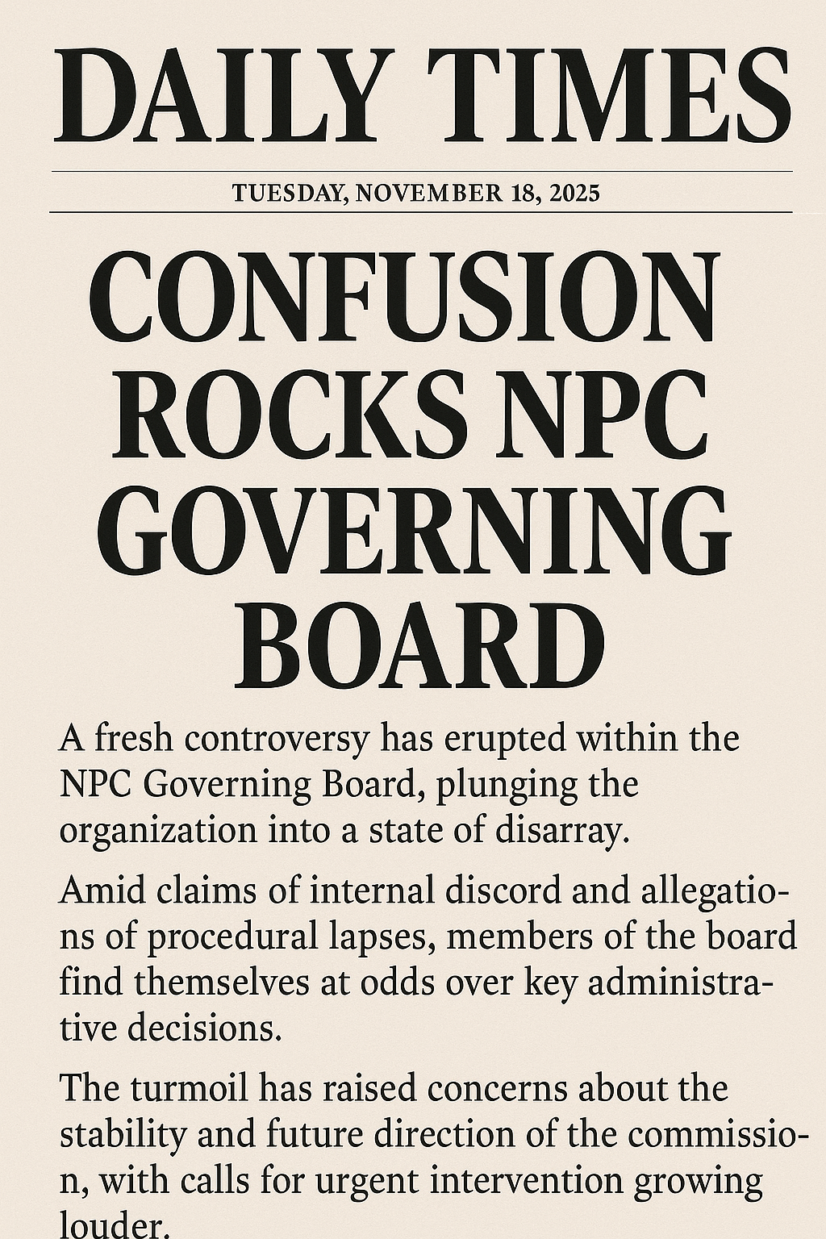
Center for International Mediators and Arbitrators
ENGLAND & WALES
Dysfunction.
This presentation examines how diverse governance bodies navigate complex challenges across different contexts. Through five distinct case studies, we explore how value differences, power dynamics, and institutional structures impact board effectiveness, funtion and decision-making processes.
Dr Osei Bonsu Dickson FCIMArb 08/07/2025

Slide 5
Center for International Mediators and Arbitrators
ENGLAND & WALES
Agenda
1
Overview of Diversity Challenges in Governance
2
Five Global Case Studies
Examining the United Nations Security Council, Iraq's Governing Council, South Sudan's Transitional Government, Kenya's Electoral Commission, and Afghanistan's Peace Negotiation Team
Understanding the nuanced challenges that emerge when diverse perspectives converge in decision-making bodies
3
Comparative Analysis
4
Key Takeaways and Recommendations
Identifying patterns of challenges across different contexts and governance structures
Actionable insights for policymakers and organizational leaders navigating diversity in governance
Presentation to NPC Governing Board

Slide 6
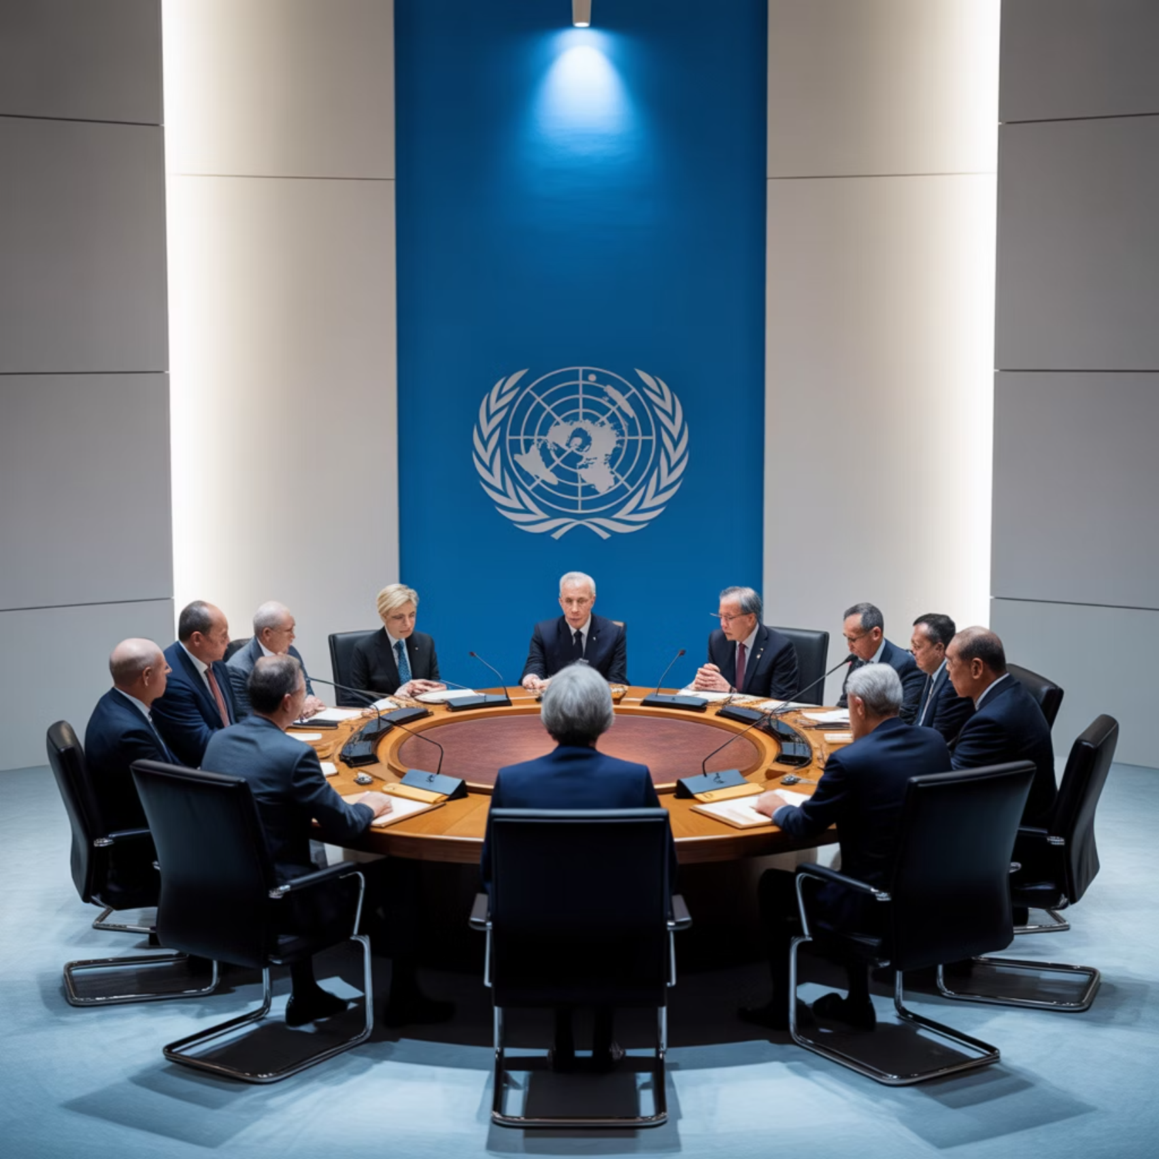
Center for International Mediators and Arbitrators
ENGLAND & WALES
United Nations Security Council (UNSC)
Nature of Diversity
The UNSC represents perhaps the most diverse high-stakes governance body globally, comprising permanent members from vastly different political systems—from liberal democracies to authoritarian regimes—with fundamentally different values, interests, and worldviews.
Key Challenges
Paralysis through veto power when deep value differences emerge
National interests consistently prioritized over global consensus
Persistent trust deficit stemming from historical ideological suspicions
The Security Council's structural diversity often leads to procedural deadlocks, particularly on humanitarian intervention and climate security issues.
Dr Osei Bonsu Dickson FCIMArb 08/07/2025
Lesson: Value diversity requires robust decision-making protocols, mediation structures,
and limits to individual power to prevent institutional paralysis.

Slide 7



Center for International Mediators and Arbitrators
ENGLAND & WALES
Iraq's Governing Council (2003-2004)
Fragmented Vision
Weak Institutional Foundation
Legitimacy Questions
Ethno-sectarian differences between Sunni, Shi'a, Kurdish, Christian, secular and tribal representatives often manifested as zero-sum politics, impeding collective decision-making and prioritization of national interests.
Widespread perception of the Council as externally imposed by the U.S.-led coalition eroded internal cohesion and public trust, hampering its effectiveness in transitional governance.
The absence of a shared constitution or strong institutional memory undermined collaborative governance, creating ad hoc decision processes that reinforced rather than bridged divisions.
Lesson: Diversity without shared legitimacy, constitutional anchoring, or inclusive ownership can significantly weaken cohesion and delay effective state-building.
Dr Osei Bonsu Dickson FCIMArb 08/07/2025

Slide 8

Center for International Mediators and Arbitrators
ENGLAND & WALES
Iraq's Governing Council: Implications
"The Iraq experiment demonstrated that representative diversity alone is insufficient; without shared institutional values and organic legitimacy, diverse boards may amplify rather than resolve societal divisions."
The case of Iraq's Governing Council reveals how externally engineered diversity without indigenous legitimacy or constitutional framework can accelerate governance challenges in post-conflict settings. Despite including representatives from all major Iraqi communities, the Council struggled to translate this demographic diversity into effective collaborative governance.
Dr Osei Bonsu Dickson FCIMArb 08/07/2025

Slide 9
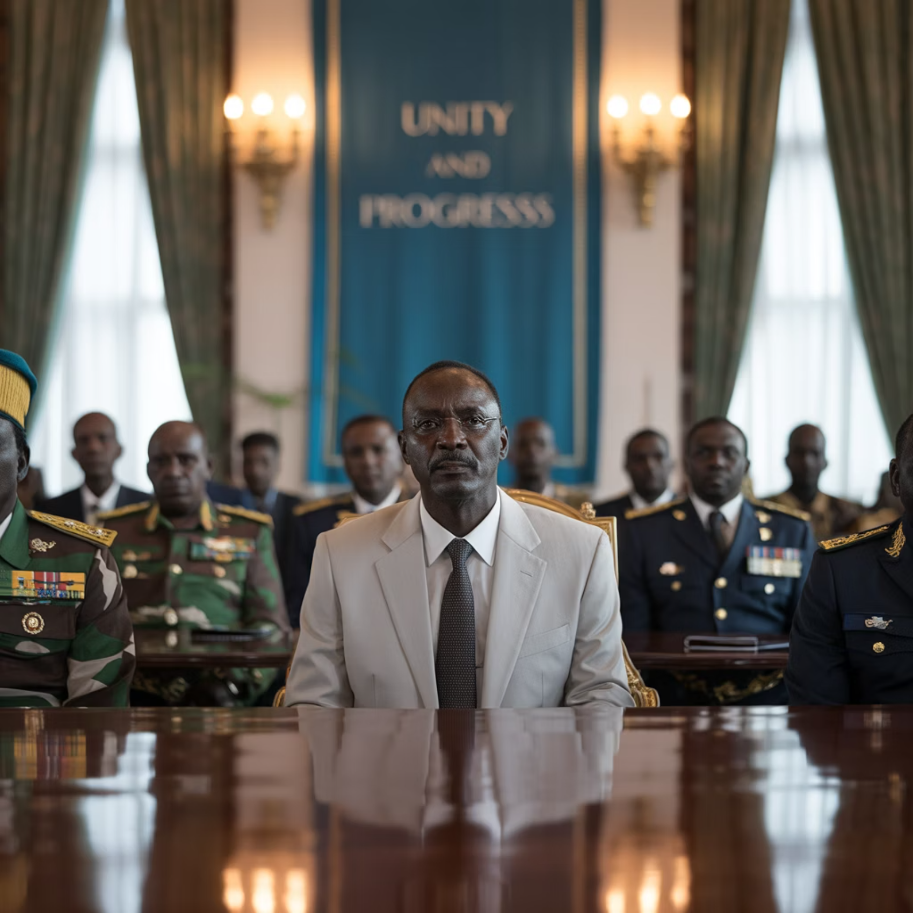
Center for International Mediators and Arbitrators
ENGLAND & WALES
South Sudan's Transitional
Government
Nature of Diversity
South Sudan's post-2018 peace deal created a government comprising former civil war enemies brought together in a power-sharing arrangement, representing a case of enforced diversity among deeply antagonistic factions.
Key Challenges
Deep-seated interpersonal and intergroup distrust stemming from recent violent conflict
Significant power imbalances that rendered the arrangement cosmetic rather than substantive
Tokenistic inclusion that rarely translated into meaningful decision-making influence
Dr Osei Bonsu Dickson FCIMArb 08/07/2025
Lesson: For diversity to yield effective governance, intentional trust-building mechanisms, capacity parity among stakeholders, and inclusive empowerment—not just symbolic appointments—are essential.

Slide 10



Kenya's Independent Electoral and Boundaries Commission (IEBC)
Perception of Partisan Bias
Erosion of Public Confidence
Inconsistent Communication
Despite attempts at balanced representation, the IEBC faced persistent allegations of partisan bias, with commissioners perceived as aligned with specific political interests rather than institutional objectives.
Internal divisions within the commission—real or perceived—translated into national tension and diminished institutional credibility, particularly during contentious electoral periods.
Failure to maintain unified messaging created information vacuums that were filled by speculation and misinformation, further undermining the commission's authority.
Lesson: In contexts where values diverge, institutional integrity, procedural transparency, and professional communication must be non-negotiable norms to preserve legitimacy and effectiveness.
Dr Osei Bonsu Dickson FCIMArb 08/07/2025

Slide 11
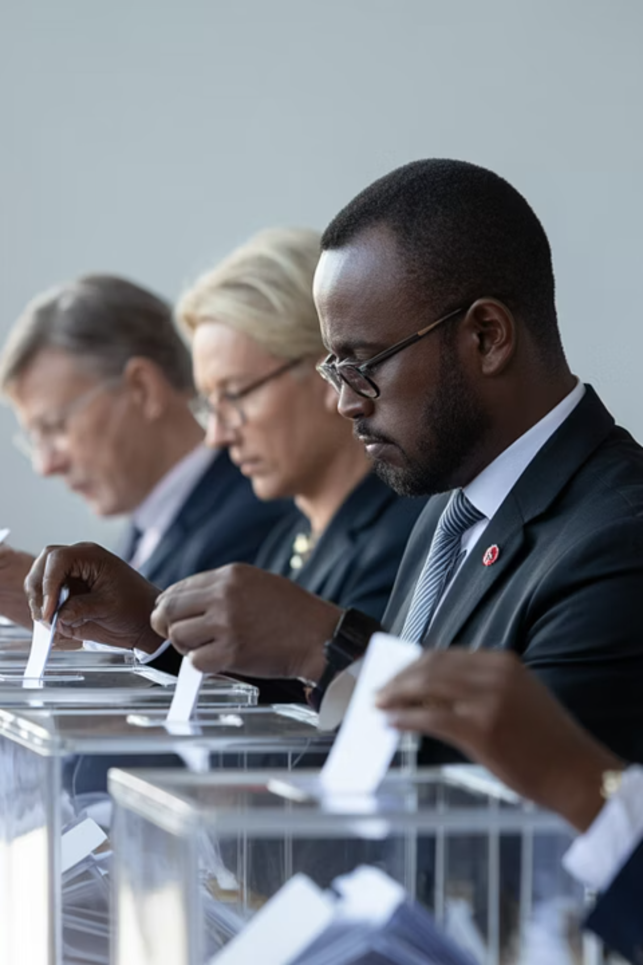
Center for International Mediators and Arbitrators
ENGLAND & WALES
Kenya's IEBC: The Challenge of Perceived Impartiality
The Independent Electoral and Boundaries Commission (IEBC) case demonstrates how value diversity within a board can become particularly problematic in high-stakes environments where impartiality is paramount. Even when commissioners act with integrity, the perception of partisan alignment can undermine the entire governance structure.
During Kenya's 2017 election, internal disagreements among commissioners spilled into public view, with some officials making contradictory statements about election processes. This visible discord significantly damaged public confidence in electoral outcomes, eventually necessitating a Supreme Court intervention and a costly election re-run.
Dr Osei Bonsu Dickson FCIMArb 08/07/2025

Slide 12
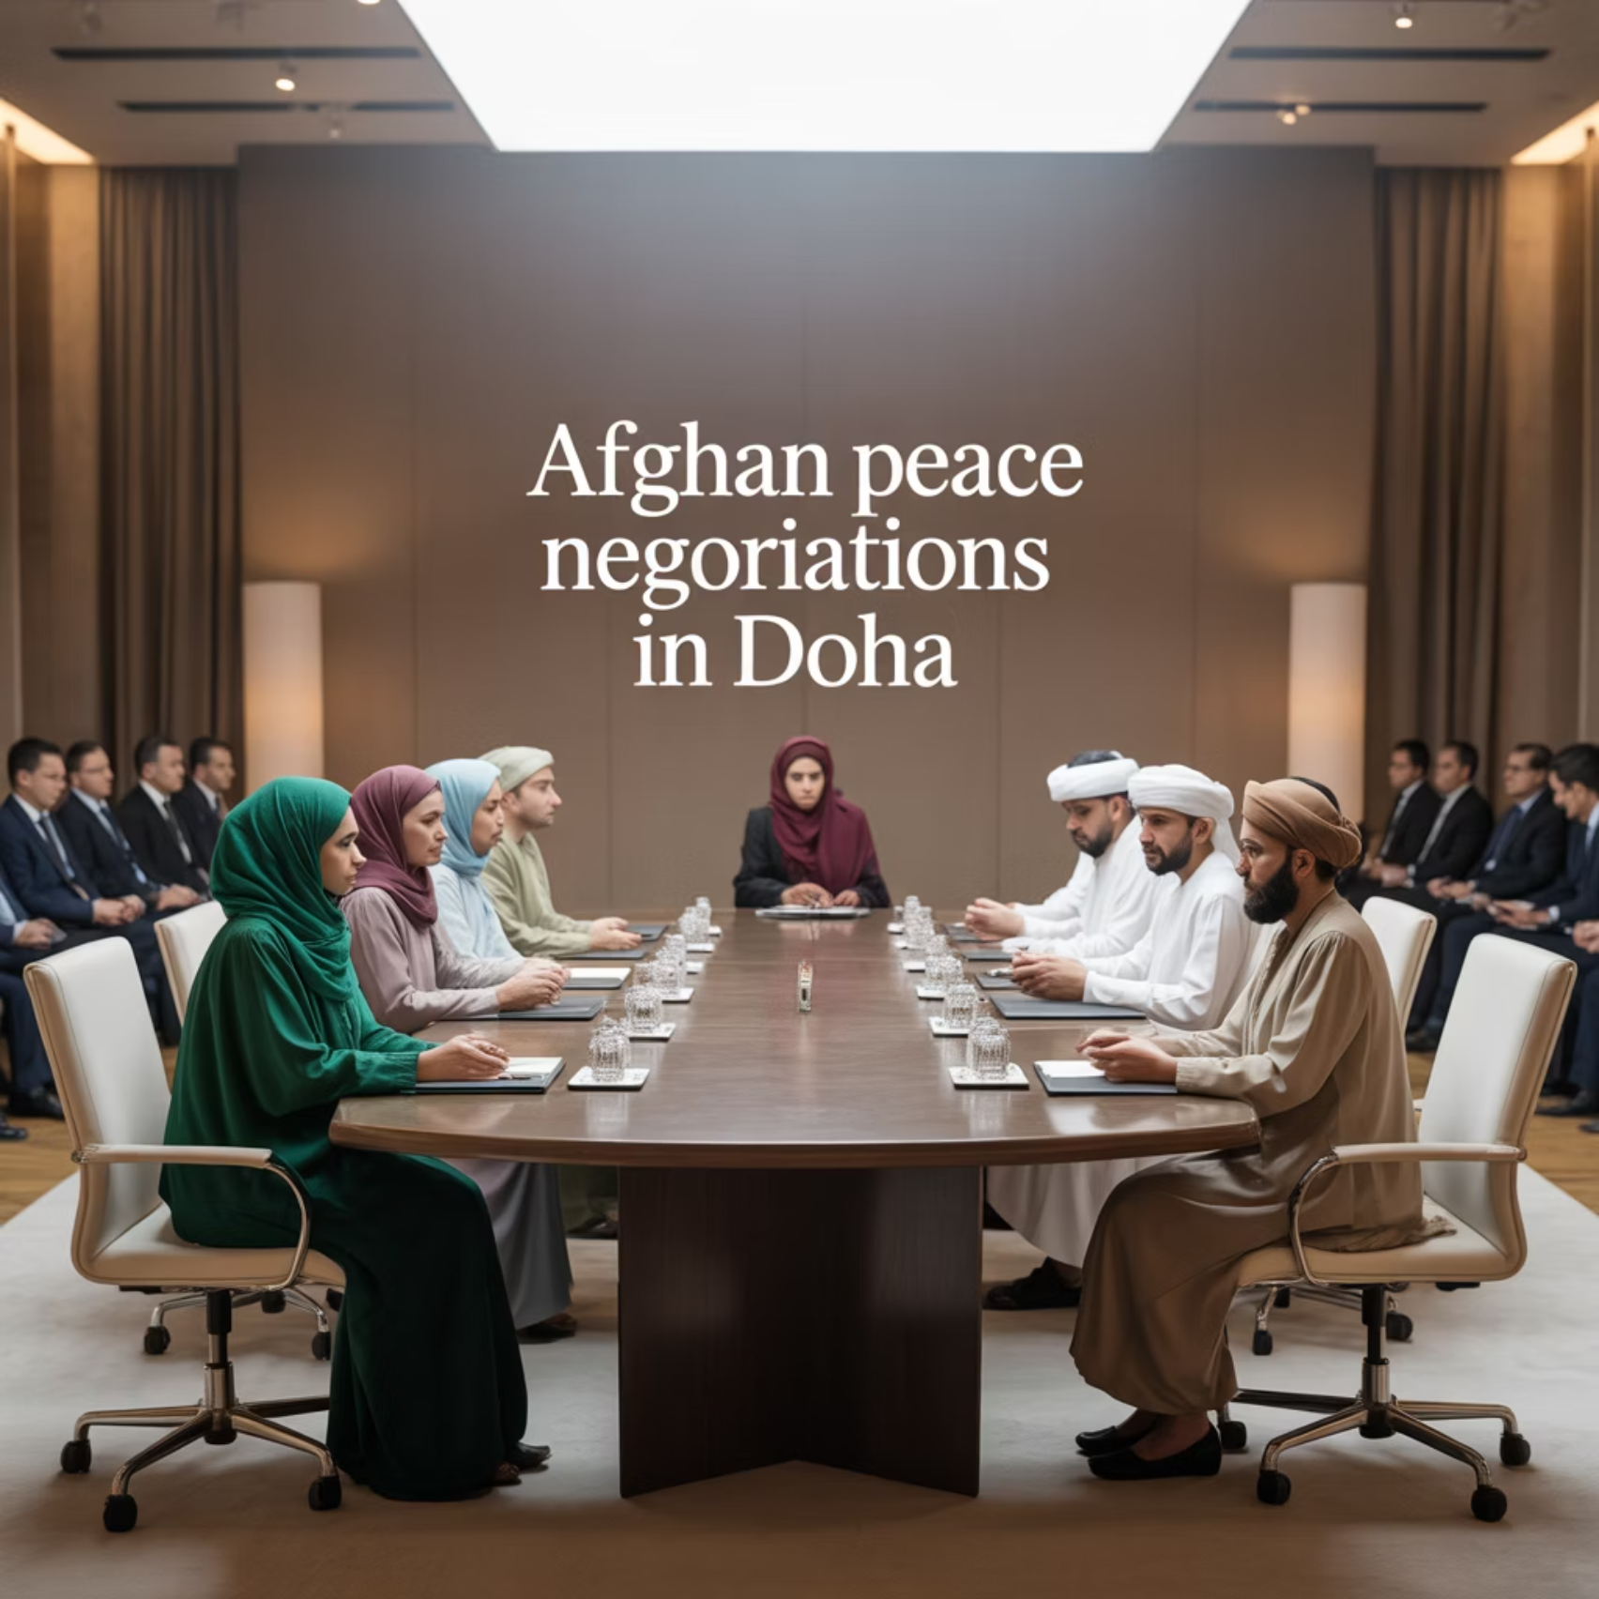
Center for International Mediators and Arbitrators
ENGLAND & WALES
Afghanistan's Peace Negotiation Team
(2020 Doha Talks)
Nature of Diversity
Afghanistan's negotiation team brought together government officials, civil society actors, and women leaders to negotiate with Taliban representatives, creating a stark value clash in worldviews, priorities, and fundamental beliefs about governance.
Key Challenges
Fundamental worldview clashes, particularly regarding gender roles, constitutional governance, and individual rights
Procedural breakdowns due to inability to agree on even basic negotiation frameworks
Security vulnerabilities that made diverse representation physically dangerous for participants
Lesson: In deeply value-fractured environments, diverse governance bodies require robust external mediation, security guarantees, and international support structures to function effectively.
Dr Osei Bonsu Dickson FCIMArb 08/07/2025

Slide 13








Center for International Mediators and Arbitrators
ENGLAND & WALES
Comparative Analysis: Patterns Across Case Studies
Power Asymmetry
Process Challenges
Across all cases, formal equality rarely translated to actual power parity. Dominant groups maintained outsized influence despite diversity structures, particularly evident in the UNSC veto system and South Sudan's transitional arrangements.
Diverse boards consistently struggled with procedural questions—how decisions should be made, consensus thresholds, and deliberation frameworks—often causing significant operational delays (particularly in Afghanistan and Iraq).
Value Conflicts
Legitimacy Deficits
Unlike demographic diversity, value diversity created the most intractable governance challenges, particularly when fundamental worldviews about rights, representation, and authority diverged significantly.
When diversity was perceived as externally imposed rather than organically developed, governance bodies faced significant legitimacy challenges, undermining their authority and effectiveness.
Dr Osei Bonsu Dickson FCIMArb 08/07/2025

Slide 14
Center for International Mediators and Arbitrators
ENGLAND & WALES
Key Takeaway: Discover Common Ground
Develop Shared Procedural Values
Balance Representation with Effectiveness
Even when substantive values differ dramatically, agreement on decision-making processes, communication protocols, and conflict resolution mechanisms is essential for functional diversity.
Prioritize both inclusive representation and governance effectiveness by creating structures that prevent deadlock while still honoring diverse perspectives and interests.
Invest in Relationship-Building
Establish Clear Accountability
Formal relations must be accompanied by intentional trust-building efforts, particularly in post-conflict settings where historical antagonisms persist among governance participants.
Create transparent mechanisms for joint accountability to prevent factional behavior and reinforce commitment to institutional rather than partisan interests.
Dr Osei Bonsu Dickson FCIMArb 08/07/2025

Slide 15
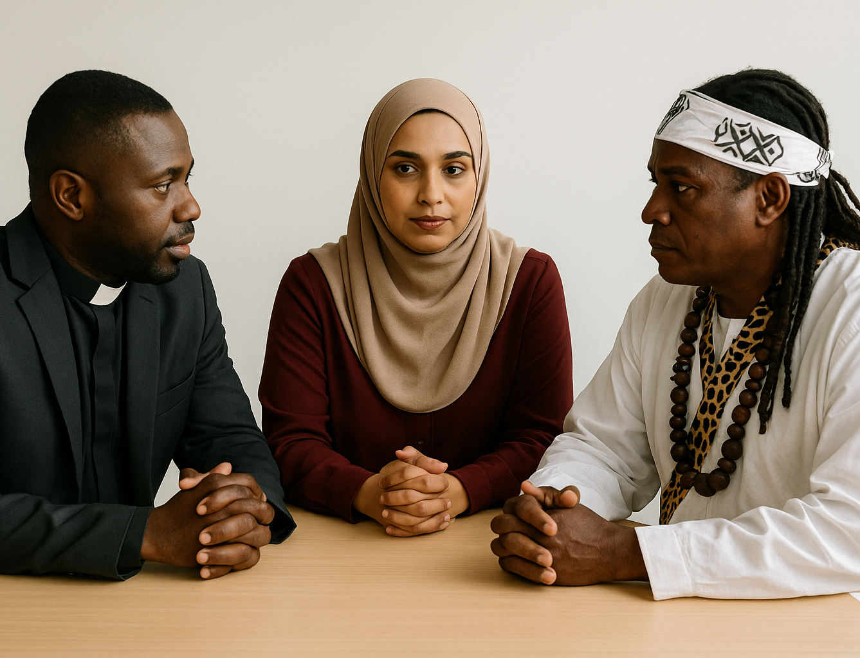
Center for International Mediators and Arbitrators
ENGLAND & WALES
Diversity
PEACE IN DIVERSITY
DISCOVERING COMMONALITIES
Diversity

Slide 16

Center for International Mediators and Arbitrators
ENGLAND & WALES
Discover commonalities through:
Shared Purpose – Aligning around a common mission or strategic goal.
Mutual Respect – Recognizing and valuing each member’s contributions and perspectives.
Open Communication – Encouraging honesty, listening, and constructive dialogue.
Trust Building – Developing confidence in each other's intentions and capabilities.

Slide 17
Center for International Mediators and Arbitrators
ENGLAND & WALES
Discover commonalities through:
Compromises – Emphasizing team over individual dominance.
Commitment to Inclusion – Ensuring all voices are heard and integrated into decisions.
Accountability – Holding one another responsible for agreed roles and outcomes.
Learning – Embracing continuous improvement, reflection, and development.
Dr Osei Bonsu Dickson FCIMArb 08/07/2025

Slide 18
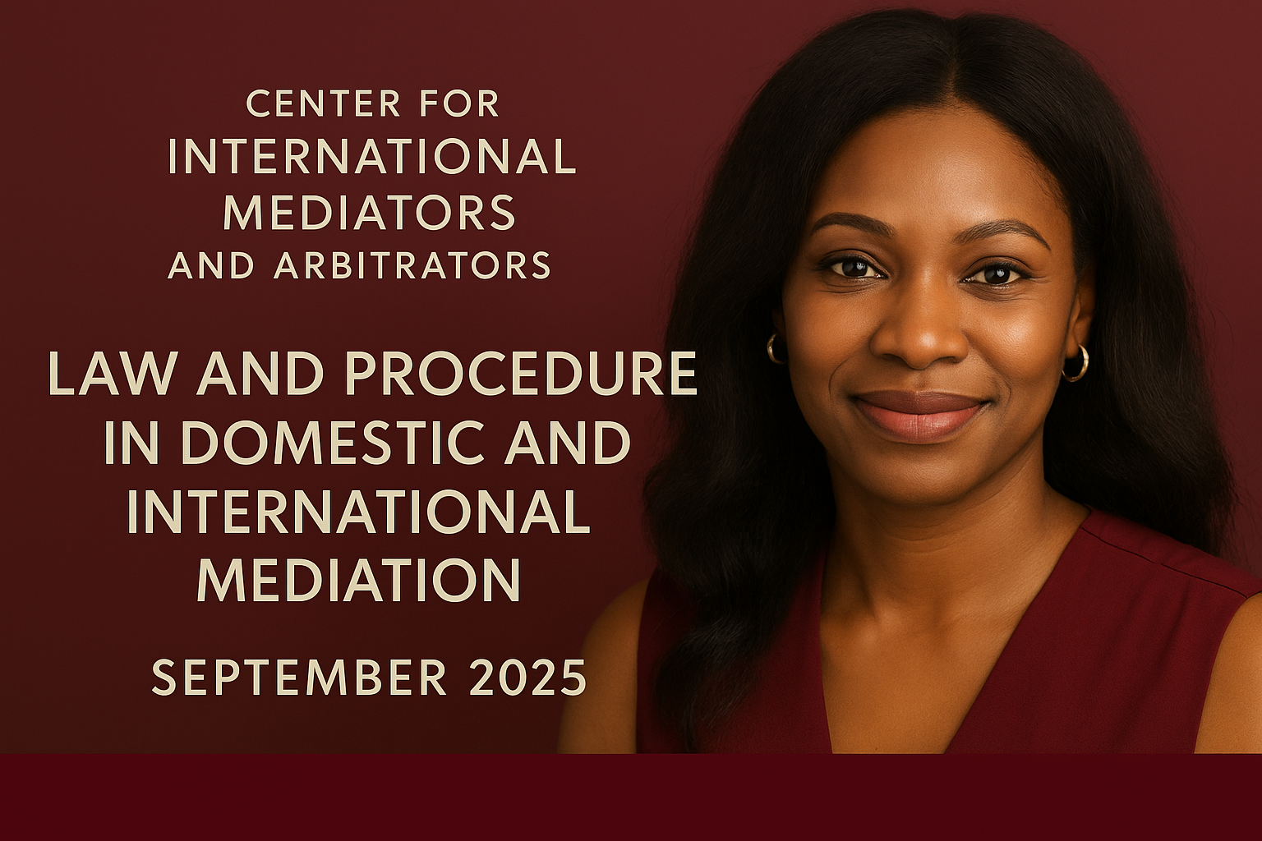

ENROLL FOR
GHS 5,500 05567305535

Slide 19
Revisiting Challenges Faced by Diverse Boards: 5 Global Case Studies
Board Governance
Dr Osei Bonsu Dickson FCIMArb
Thank you
Center for International Mediators and Arbitrators
ENGLAND & WALES

