Slide 1

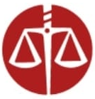

Center for International Mediators
and Arbitrators
England & Wales
Oxfordshire-Africa Forum on
International Arbitration
非洲地區副總裁
“The arbitration landscape in Africa is experiencing unprecedented transformation.” – Dr Osei Bonsu Dickson, CIMA Workshop Italy
Arbitration Trends In Africa: Transformation & Opportunity
Dr Osei Bonsu Dickson FCIMArb, Barrister

Slide 2





CIMA AI LAB
AI and The Future of
Arbitration
Meet Michael Smith
Lead AI Facilitaor , CIMA

Slide 3





African Arbitration: Growth & Transformation
Rapid Growth
Arbitration cases across Africa increased by 35% through 2024-2025.
Shifting Centers
New arbitration hubs emerging beyond traditional locations.
ICCA-KIAC Conference
Landmark event scheduled for June 5, 2025 in Kigali, Rwanda.
CIMA’s Qualitative Development Push
CIMA is pushing for improved frameworks and institutional
capacity building across jurisdictions.

Slide 4





Key African Arbitration Developments (2024)
Legislative Reforms
Multiple jurisdictions modernized arbitration laws to align with international standards.
Judicial Support
Courts increasingly uphold arbitration agreements and awards.
Institutional Growth
Regional arbitration centers reported 40% increase in caseload.
Cross-Border Cooperation
Enhanced frameworks for recognition and enforcement of awards.

Slide 5

CIMA's Arbitration Revolution
CIMA 2024 Oxfordshire-Africa Conference
Pivotal arbitration framework developed at Worcester College,
Oxford University to modernize dispute resolution in Africa ORD.
Pro-Arbitration Engagement an Training with African
Bar Associations
Law Society of Sierra Lone, Liberia and Ghana consistently upholding
interest in Arbitration and mediation.
Program with University of Ghana School of Law
Groundbreaking Training with LLM. Maritime Programme
Pro-Arbitration Engagement an Training with
Law Society of Kenya / Uganda
Precedent-setting $1.9M award successfully enforced.

Slide 6








Third-Party Funding: Game-Changer for Africa
Exponential Growth
85% increase in TPF utilization since 2024
Access Expansion
Enabling participation for financially constrained parties
Key Sectors
Technology, construction, and energy lead in TPF usage
Regulatory Needs
Frameworks required to address ethical concerns

Slide 7
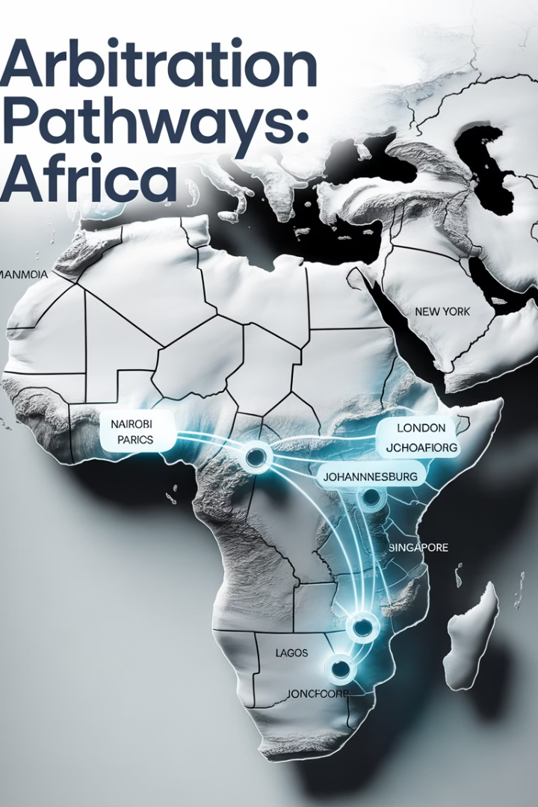
Emerging Arbitration Hubs in Africa
Rwanda
Positioning as East Africa's premier arbitration center. KIAC reported 65% case increase in 2024.
South Africa
Reformed framework attracting international disputes. New International Arbitration Act fully implemented.
North Africa
Egypt and Morocco developing specialized commercial arbitration facilities. CRCICA expanding operations.
West Africa
Regional cooperation through OHADA. Nigeria's new arbitration framework gaining prominence.

Slide 8








AfCFTA's Impact on Arbitration
Dispute Resolution Mechanisms
Cross-Border Frameworks
CIMA engaging AfCFTA for streamlined procedures for multi-jurisdictional business disputes
Dedicated protocols for commercial conflicts within AfCFTA framework
Investment Protocols
Harmonized Practices
Specialized mechanisms for investor-state dispute resolution
Standardization of arbitration procedures across member states

Slide 9

Case Study: Rwanda's Arbitration Evolution
Neutral Venue Recognition
Infrastructure Investment
Revenue Authority Case
Growing selection as seat for disputes between parties from different African regions.
ICCA Conference Host
$15M dedicated to arbitration facilities and practitioner training programs.
Selected to host prestigious International Council for Commercial Arbitration conference in June 2025.
Landmark decision established finality of arbitral awards against government entities.

Slide 10
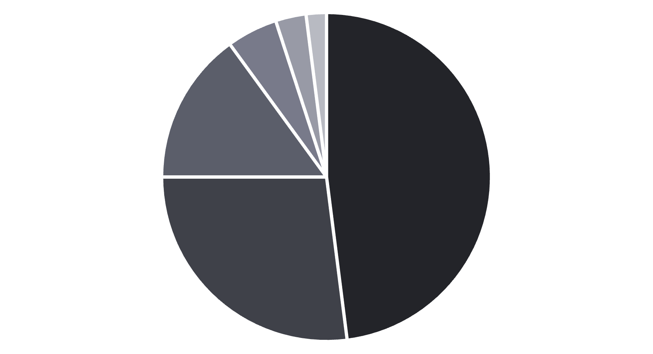
Diversity in Arbitration: African Perspective
Europe
North America
Asia
Africa
South America
Oceania

Slide 11
Gender Equality in Arbitration
Current Statistics
Key Initiatives
Women represent only 21% of arbitrators in African cases. This marks a 5% increase from 2022.
African Women in Arbitration Network launched in 2024
Pledge for Equal Representation adopted by 35 institutions
Only 15% of sole arbitrator appointments are women. Panel appointments show slightly better figures at 24%.
Mentorship programs connecting 250+ practitioners
Database of qualified female arbitrators expanded

Slide 12





Racial & Ethnic Diversity Initiatives
CIMA’s DIAL Project
Appointment Programs
Cross-Cultural Competency
Linguistic Diversity
Enhanced translation services for proceedings. Support for indigenous languages in appropriate disputes.
Initiatives targeting balanced representation in arbitrator selection. 15 institutions adopted diversity protocols in 2024.
Training programs for international practitioners. Over 500 arbitrators completed cultural sensitivity certification.
Customary Law Integration
Recognition of indigenous legal principles. Specialized training for arbitrators in traditional dispute resolution.

Slide 13
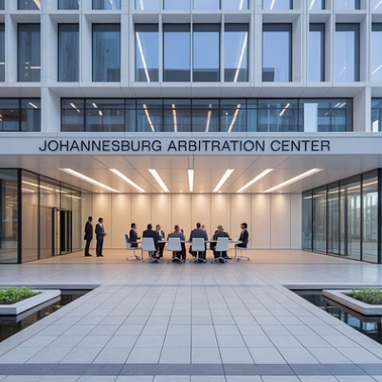
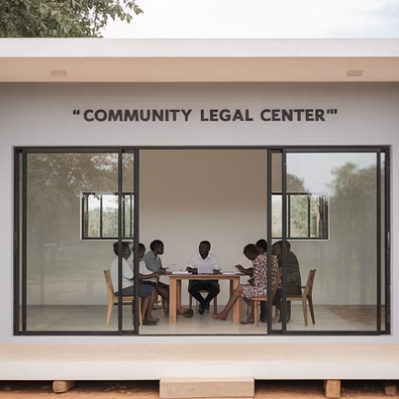
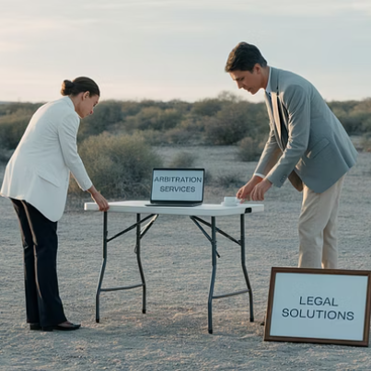

Geographical Diversity & Inclusion
Geographical barriers continue to limit arbitration access. Digital solutions and mobile services are bridging these divides across Africa.

Slide 14





Green Arbitration: African Innovation
African Green Arbitration Initiative
Launched in 2024 with 28 founding institutions across the continent.
Paperless Proceedings
Digital documentation reduced paper usage by 85% in participating institutions.
Remote Hearings
Virtual proceedings cut carbon emissions by 60% compared to in-person hearings.
Environmental Impact Metrics
Standardized measurement protocols track sustainability improvements.

Slide 15








ESG Factors in African Arbitration
Social Impact
Community rights and labor standards featured in 65% of investment disputes. Indigenous consultation becoming procedural requirement.
Governance Factors
Anti-corruption provisions affecting enforcement outcomes. Transparency requirements reshaping procedural approaches.
Environmental Considerations
Extractive industry disputes increasingly evaluate ecological impact. Carbon footprint assessments now standard in mining arbitrations.
ESG Reporting
Disclosure obligations impacting dispute resolution strategies. Integrated reporting frameworks gaining traction.

Slide 16
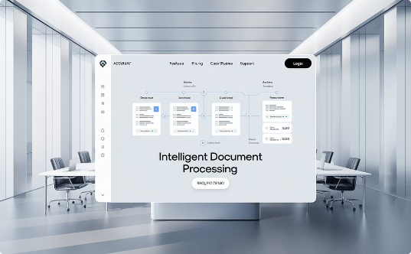

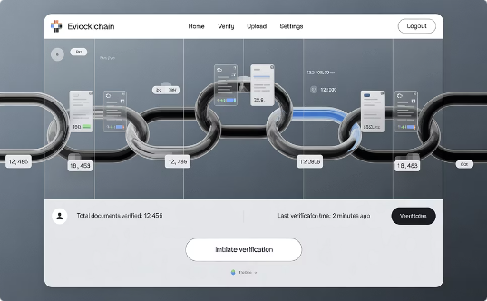
Technology Transforming African Arbitration
AI Document Analysis
Virtual Hearings
Blockchain Verification
Machine learning tools process thousands of documents in hours. Adoption increased 120% in 2024.
Advanced platforms enable seamless remote participation. 65% of hearings now include virtual elements.
Immutable evidence records enhance integrity. Pilot programs launched in 5 major institutions.

Slide 17
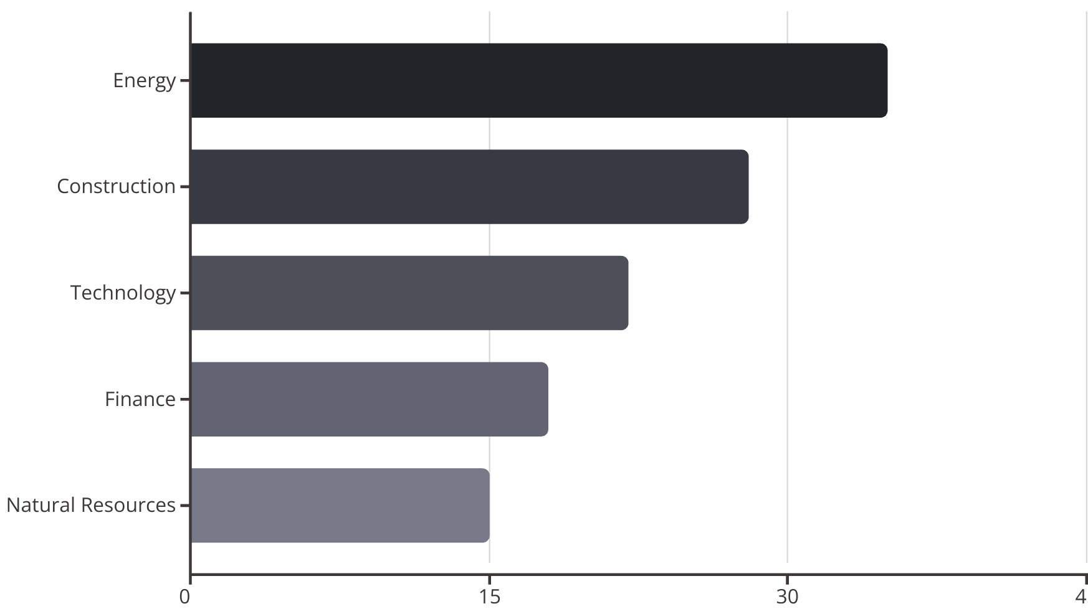
Industry-Specific Arbitration Trends

Slide 18




Arbitration Career Pathways in Africa
Entry Level
Specialized education and initial practice experience
Counsel Experience
Representing clients in arbitration proceedings
Arbitrator Appointments
Beginning with sole arbitrator roles in smaller disputes
Institutional Leadership
Roles within arbitration centers and policy development

Slide 19



Professional Development Resources
Certifications
Specialized qualifications from accredited institutions. CIArb courses now available in 12 African countries.
Mentorship Programs
Structured guidance from experienced practitioners. 350+ mentor-mentee relationships established in 2024.
International Exchanges
Cross-border learning opportunities expanding horizons. Scholarship programs supporting talent development.

Slide 20

Continuing Education Requirements
Jurisdiction
Annual CPD Hours
Specialized Requirements
Nigeria
20
5 hours ethics training
South Africa
15
Technology competency verification
Kenya
18
Cultural sensitivity module
Egypt
12
International law updates
Rwanda
25
ESG certification requirement

Slide 21

Building an Arbitration Practice
Service Definition
Develop clear specialized arbitration service offerings. Focus on specific industries or dispute types.
Network Development
Build connections across jurisdictions. Join professional associations and attend key conferences.
Thought Leadership
Publish articles and speak at events. Establish expertise through content creation and sharing.
Institutional Engagement
Seek panel appointments at arbitration centers. Participate in institutional committees and initiatives.

Slide 22

Challenges in African Arbitration
Enforcement Difficulties
Some jurisdictions still resist recognition of foreign awards. Procedural hurdles delay enforcement in 35% of cases.
Regulatory Inconsistencies
Varying legal frameworks across borders complicate cross-jurisdictional practice. Harmonization efforts ongoing but incomplete.
Resource Limitations
Smaller practitioners struggle with research access and technology costs. Economic disparities affect competitive landscape.
Political Interference
Government influence remains problematic in certain regions. Independence of arbitration requires continued vigilance.

Slide 23
Future Trends: 2025 and Beyond
AI Integration
Climate Dispute Resolution
Digital Asset Arbitration
Artificial intelligence moving beyond document management into decision support systems. Predictive analytics for outcome forecasting gaining traction.
Cryptocurrency and blockchain disputes requiring specialized expertise. Four major institutions launched digital asset arbitration rules in 2024.
Specialized mechanisms for climate change disputes emerging rapidly. Carbon credit disputes expected to rise 300% by 2027.
Ethical frameworks for AI in arbitration developing alongside technological advances. Ensuring human oversight remains essential.
Environmental impact assessments becoming standard in multiple sectors. Green arbitration protocols expanding beyond procedural matters.
Smart contract automation of certain arbitration processes being piloted. Technical arbitrator qualifications evolving rapidly.

Slide 24





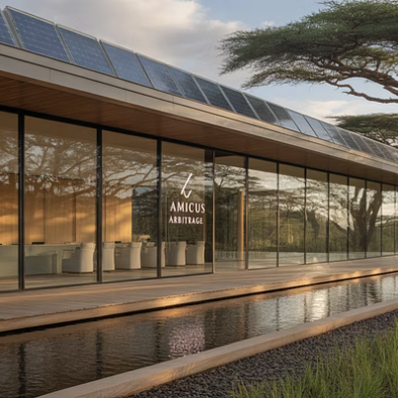
Case Studies: Success Stories
These success stories demonstrate the remarkable progress in African arbitration. Breakthroughs in representation, technology, and sustainability are transforming the field.

Slide 25
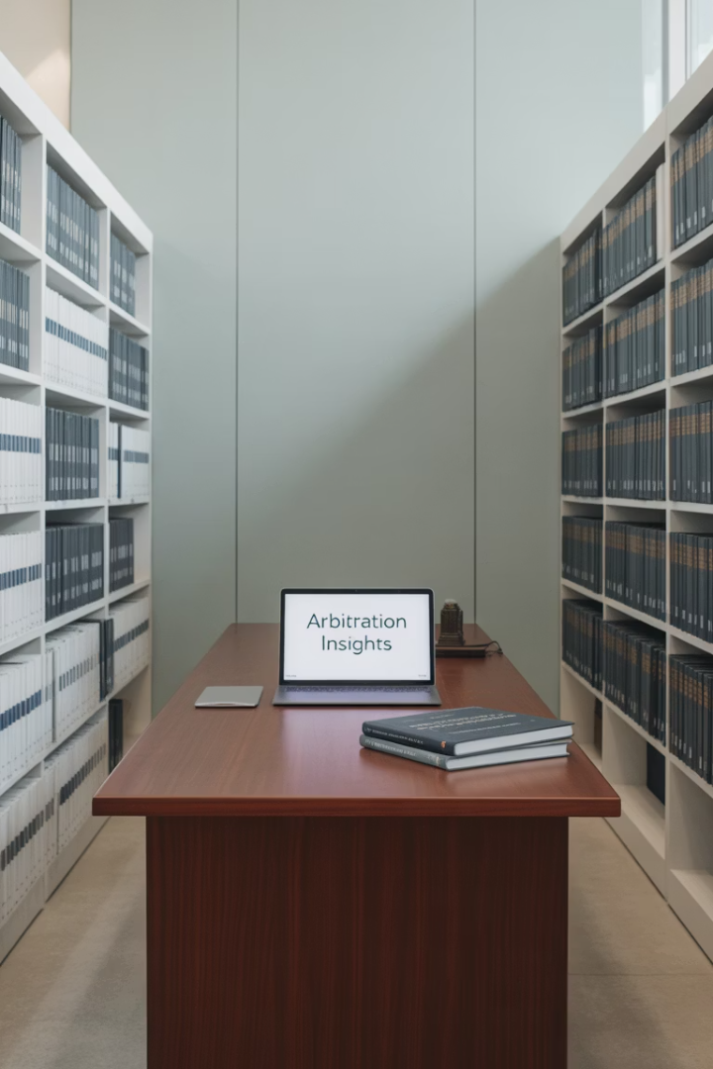
Resources for Further Learning
45+
Key Publications
Specialized journals and books on African arbitration
12
Research Institutions
Think tanks dedicated to arbitration development
8
Online Platforms
Digital learning resources with specialized content
25+
Annual Conferences
Networking events across the continent

Slide 26






Conclusion: The Future of African Arbitration
Global Influence
Shaping international arbitration norms and practices
Diverse Leadership
Inclusive representation creating competitive advantage
Sustainability Integration
Environmental and ethical principles at the core
Technological Transformation
Innovation driving efficiency and accessibility
Continued Growth
Projected 200% expansion by 2030

Slide 27
AI and The Future of
African Arbitration
Meet Michael Smith
Lead AI Facilitaor , CIMA

